Slide 1
Combinatorial Proofs
Combinatorial Proofs
The Principle of Inclusion-Exclusion
Lecture 13A, CS70 Fall 2025

Slide 2
Combinatorial Proofs
We saw that we can use our counting problem solutions to help us write proofs.
Last time, we (briefly) covered a proof of the binomial theorem.
Let’s see one more small example, followed by a much bigger example.

Slide 3
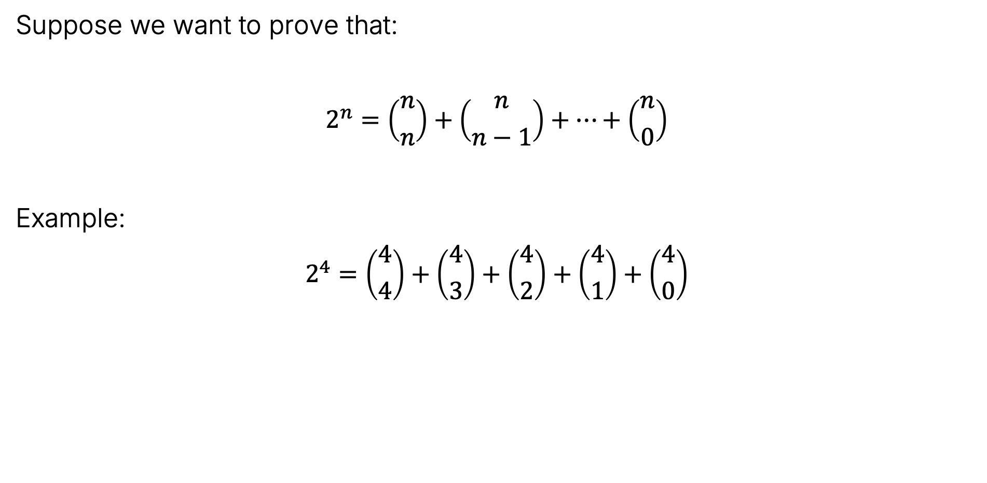
A Toy Problem
Suppose we want to prove that:
$$2^{n}=\left({n \atop n}\right)+\left({n \atop n−1}\right)+…+\left({n \atop 0}\right)$$
Example:
$$2^{4}=\left({4 \atop 4}\right)+\left({4 \atop 3}\right)+\left({4 \atop 2}\right)+\left({4 \atop 1}\right)+\left({4 \atop 0}\right)$$
$$=1+4+6+4+1$$

Slide 4
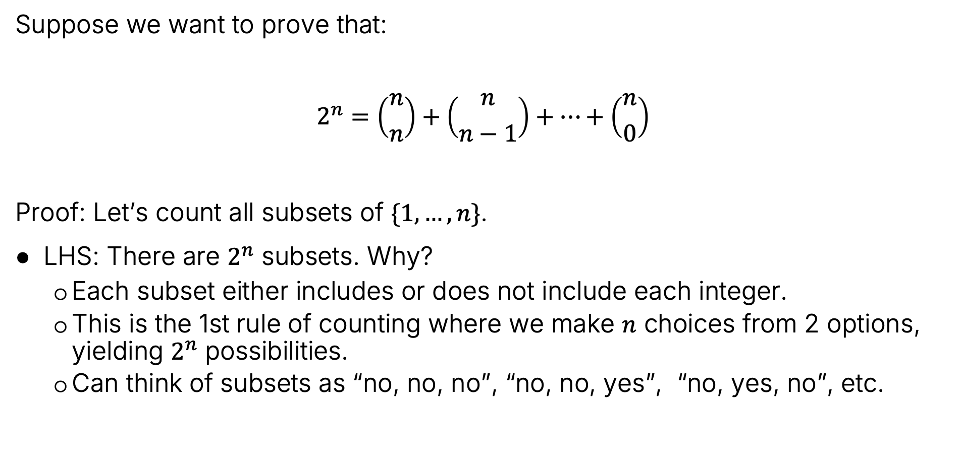
A Toy Problem
Suppose we want to prove that:
$$2^{n}=\left({n \atop n}\right)+\left({n \atop n−1}\right)+…+\left({n \atop 0}\right)$$
Proof: Let’s count all subsets of $\{1,…,n\}$.
LHS: There are $2^{n}$ subsets. Why?
Each subset either includes or does not include each integer.
This is the 1st rule of counting where we make $n$ choices from 2 options, yielding $2^{n}$ possibilities.
Can think of subsets as “no, no, no”, “no, no, yes”, “no, yes, no”, etc.

Slide 5
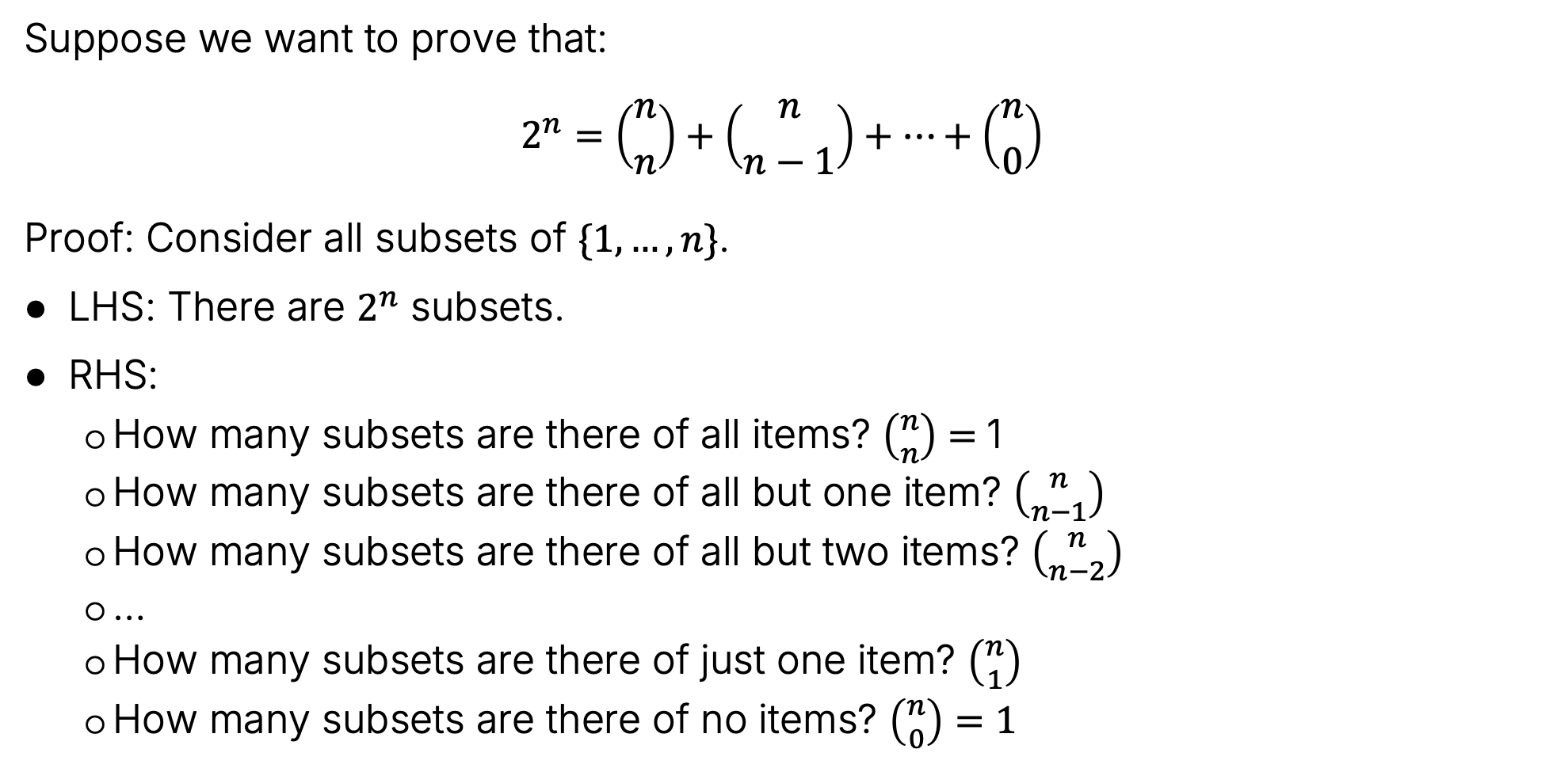
A Toy Problem
Suppose we want to prove that:
$$2^{n}=\left({n \atop n}\right)+\left({n \atop n−1}\right)+…+\left({n \atop 0}\right)$$
Proof: Consider all subsets of $\{1,…,n\}$.
LHS: There are $2^{n}$ subsets.
RHS:
How many subsets are there of all items? $\left({n \atop n}\right)=$1
How many subsets are there of all but one item? $\left({n \atop n−1}\right)$
How many subsets are there of all but two items? $\left({n \atop n−2}\right)$
…
How many subsets are there of just one item? $\left({n \atop 1}\right)$
How many subsets are there of no items? $\left({n \atop 0}\right)=1$
{1, 2, 3}, {1, 2, 4}, {1, 3, 4},
{2, 3, 4}

Slide 6
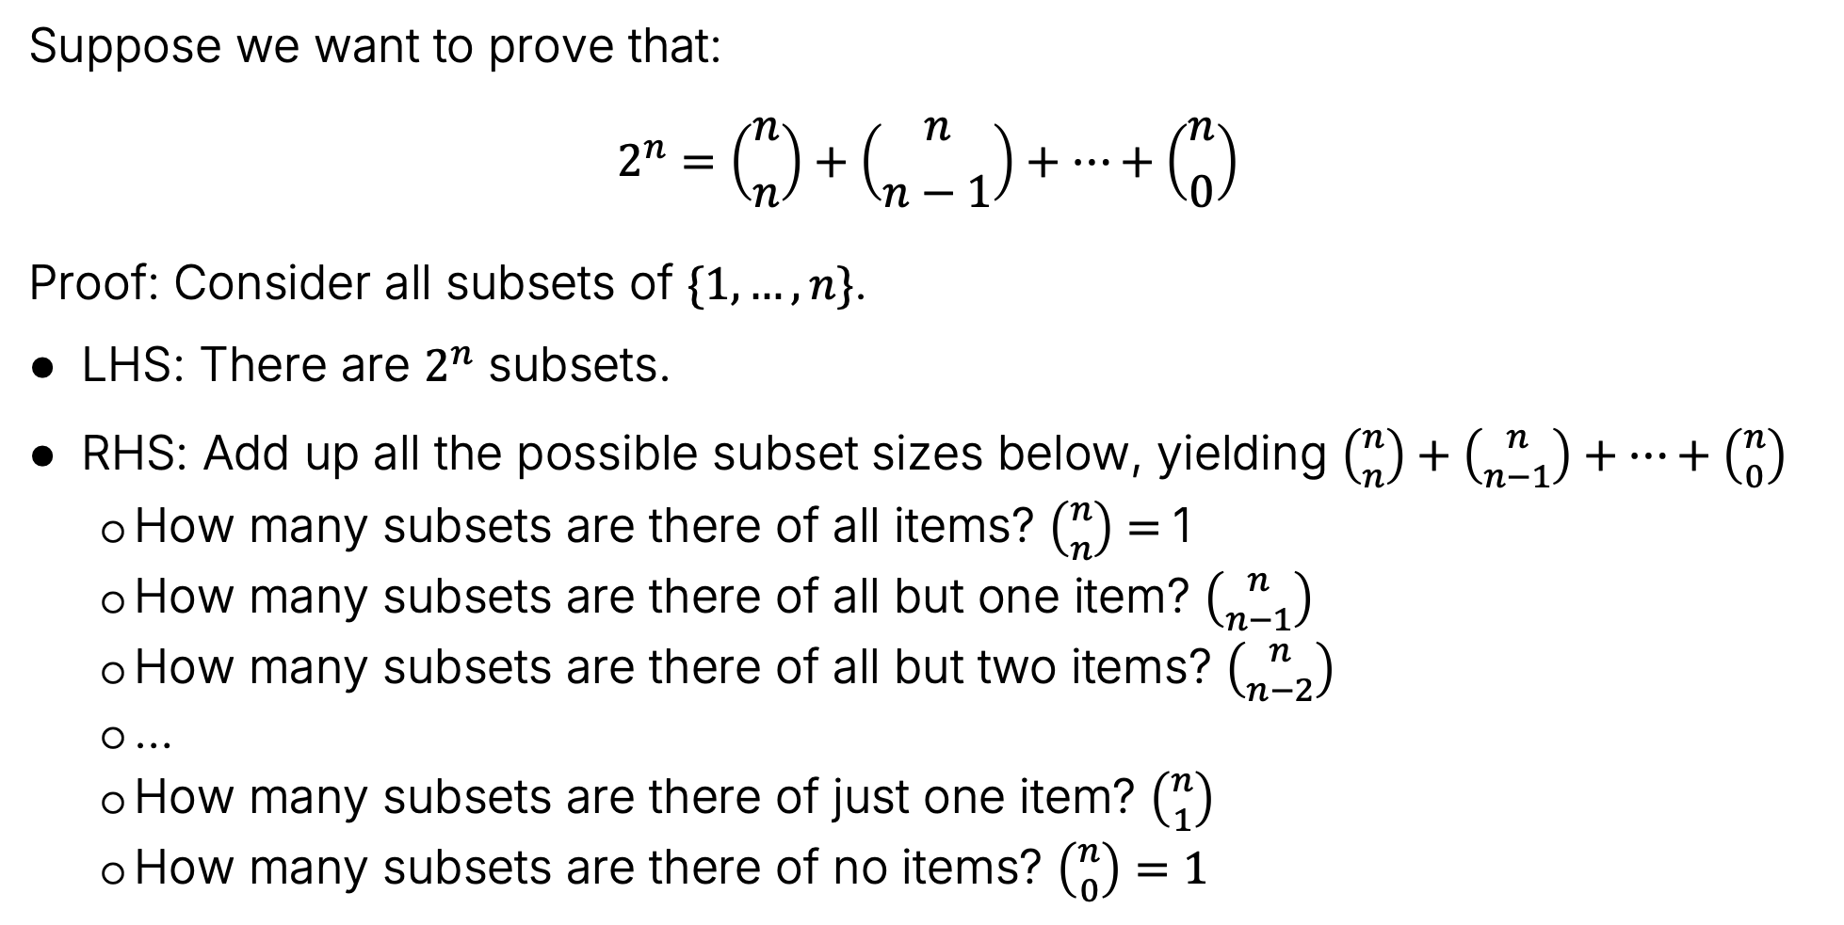
A Toy Problem
Suppose we want to prove that:
$$2^{n}=\left({n \atop n}\right)+\left({n \atop n−1}\right)+…+\left({n \atop 0}\right)$$
Proof: Consider all subsets of $\{1,…,n\}$.
LHS: There are $2^{n}$ subsets.
RHS: Add up all the possible subset sizes below, yielding $\left({n \atop n}\right)+\left({n \atop n−1}\right)+…+\left({n \atop 0}\right)$
How many subsets are there of all items? $\left({n \atop n}\right)=$1
How many subsets are there of all but one item? $\left({n \atop n−1}\right)$
How many subsets are there of all but two items? $\left({n \atop n−2}\right)$
…
How many subsets are there of just one item? $\left({n \atop 1}\right)$
How many subsets are there of no items? $\left({n \atop 0}\right)=1$

Slide 7
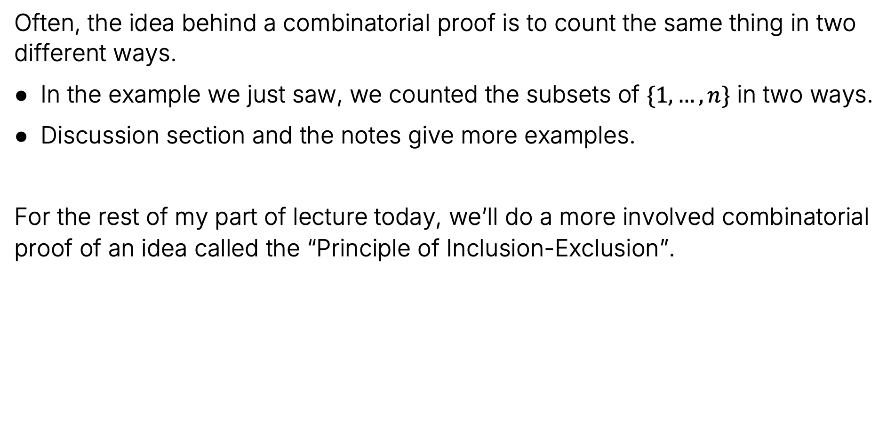
Combinatorial Proofs in General
Often, the idea behind a combinatorial proof is to count the same thing in two different ways.
In the example we just saw, we counted the subsets of $\{1,…,n\}$ in two ways.
Discussion section and the notes give more examples.
For the rest of my part of lecture today, we’ll do a more involved combinatorial proof of an idea called the “Principle of Inclusion-Exclusion”.

Slide 8
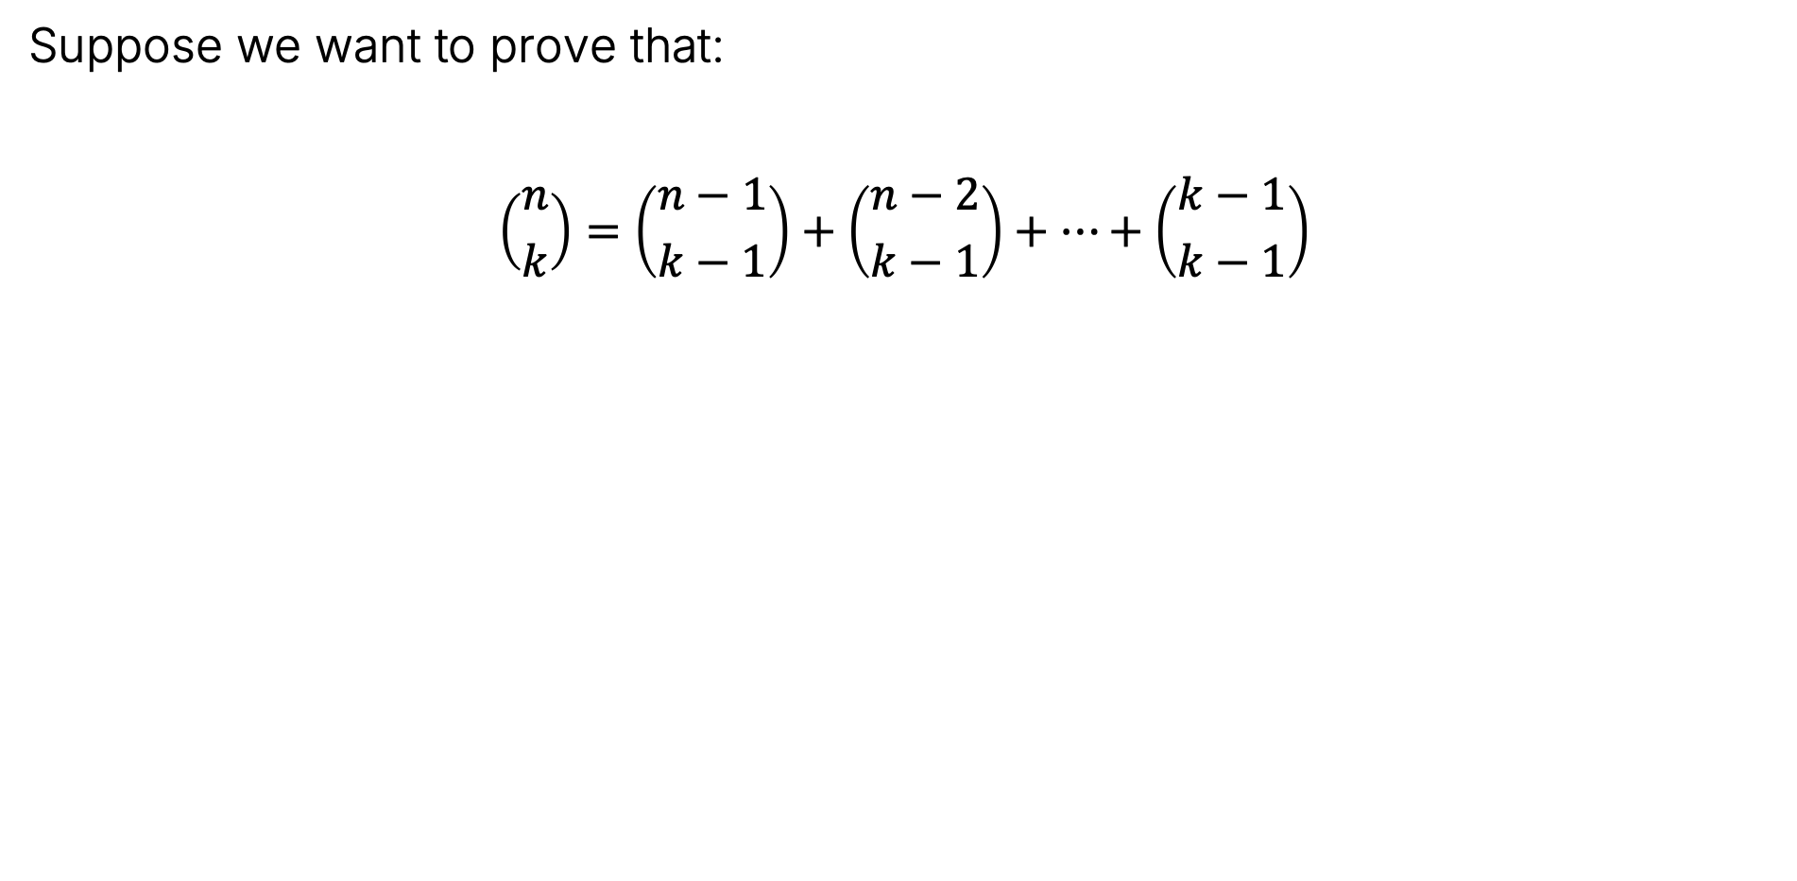
A Toy Problem
Suppose we want to prove that:
$$\left({n \atop k}\right)=\left({n−1 \atop k−1}\right)+\left({n−2 \atop k−1}\right)+…+\left({k−1 \atop k−1}\right)$$

Slide 9
The Principle of Inclusion-Exclusion
Combinatorial Proofs
The Principle of Inclusion-Exclusion
Lecture 13A, CS70 Fall 2025

Slide 10
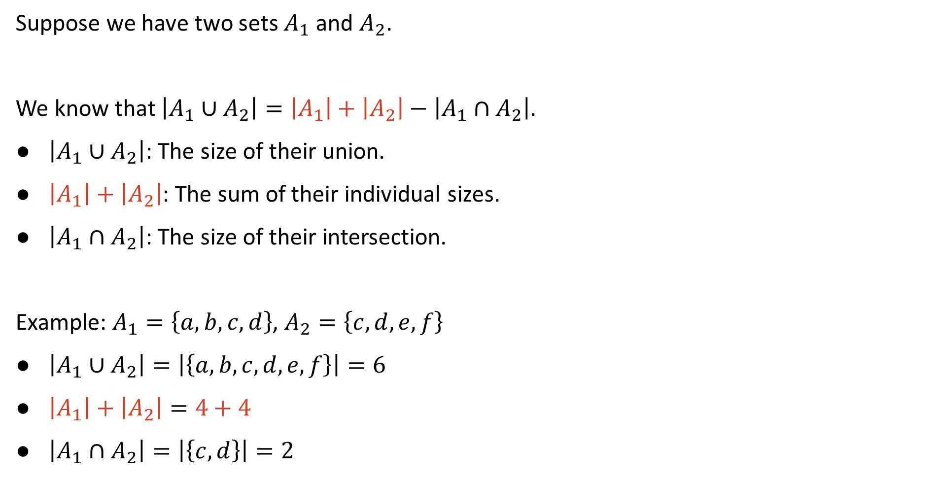
The Size of the Union of Two Sets
Suppose we have two sets $A_{1}$ and $A_{2}$.
We know that $\left|A_{1}∪A_{2}\right|=\left|A_{1}\right|+\left|A_{2}\right|−\left|A_{1}∩A_{2}\right|$.
$\left|A_{1}∪A_{2}\right|$: The size of their union.
$\left|A_{1}\right|+\left|A_{2}\right|$: The sum of their individual sizes.
$\left|A_{1}∩A_{2}\right|$: The size of their intersection.
Example: $A_{1}=\left\{a, b, c, d\right\}$, $A_{2}=\left\{c, d, e, f\right\}$
$\left|{A_{1}∪A}_{2}\right|=\left|\left\{a, b, c, d, e, f\right\}\right|=6$
$\left|A_{1}\right|+\left|A_{2}\right|=4+4$
$\left|A_{1}∩A_{2}\right|=\left|\left\{c,d\right\}\right|=2$
$$\left|{A_{1}∪A}_{2}\right|=4+4−2$$

Slide 11
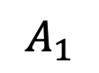
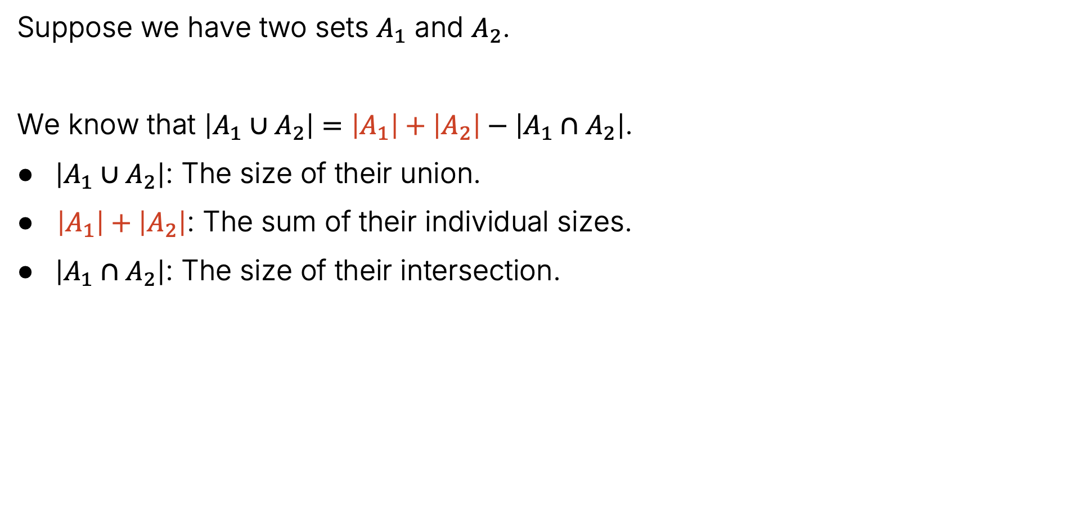
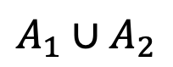
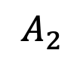
Set Union Size (Visually)
Suppose we have two sets $A_{1}$ and $A_{2}$.
We know that $\left|A_{1}∪A_{2}\right|=\left|A_{1}\right|+\left|A_{2}\right|−\left|A_{1}∩A_{2}\right|$.
$\left|A_{1}∪A_{2}\right|$: The size of their union.
$\left|A_{1}\right|+\left|A_{2}\right|$: The sum of their individual sizes.
$\left|A_{1}∩A_{2}\right|$: The size of their intersection.
$$A_{1}∪A_{2}$$
$$A_{1}$$
$$A_{2}$$

Slide 12

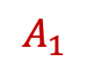

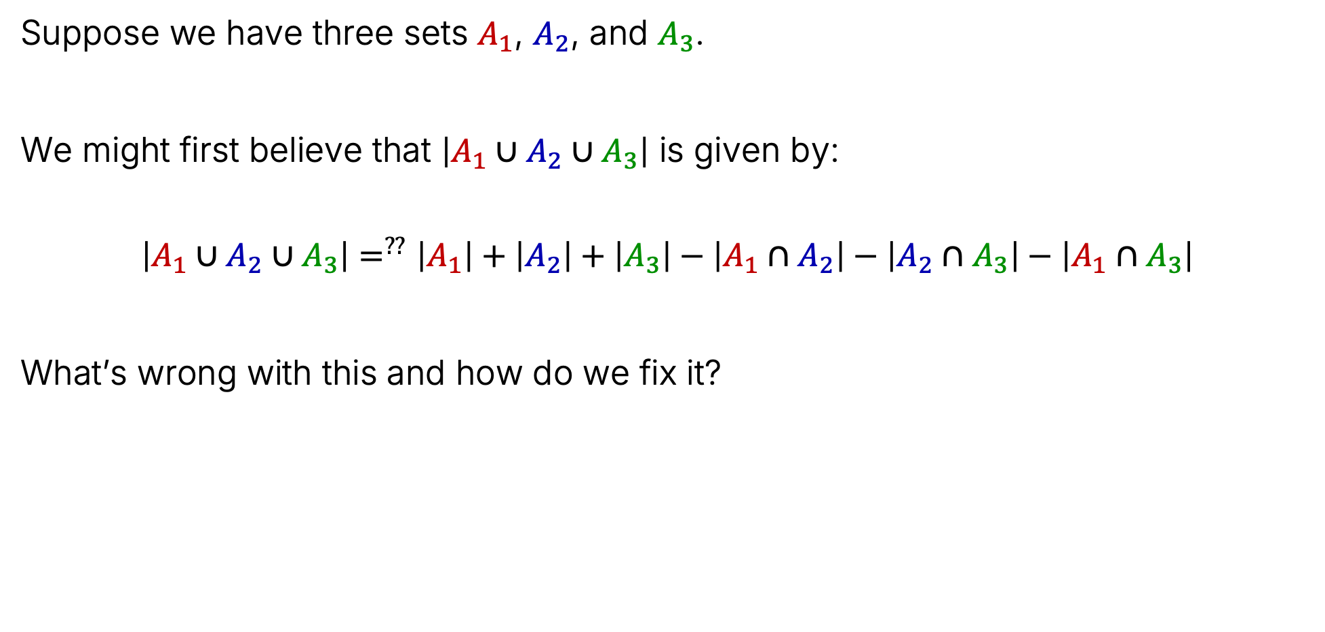

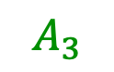
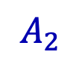
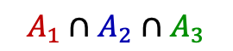
For Three Sets
Suppose we have three sets $A_{1}$, $A_{2}$, and $A_{3}$.
We might first believe that $\left|A_{1}∪A_{2}∪A_{3}\right|$ is given by:
$$\left|A_{1}∪A_{2}∪A_{3}\right|=^{??}\left|A_{1}\right|+\left|A_{2}\right|+\left|A_{3}\right|−\left|A_{1}∩A_{2}\right|−\left|A_{2}∩A_{3}\right|−\left|A_{1}∩A_{3}\right|$$
What’s wrong with this and how do we fix it?
$$A_{3}$$
$$A_{1}∩A_{3}$$
$$A_{2}∩A_{3}$$
$$A_{1}∩A_{2}∩A_{3}$$
$$A_{1}∩A_{2}$$
$$A_{1}$$
$$A_{2}$$

Slide 13
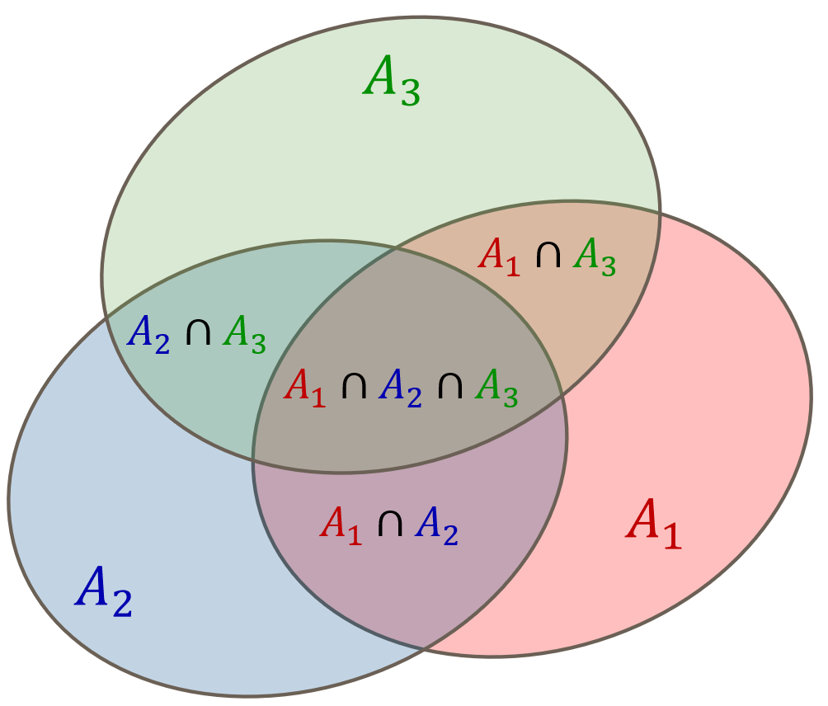
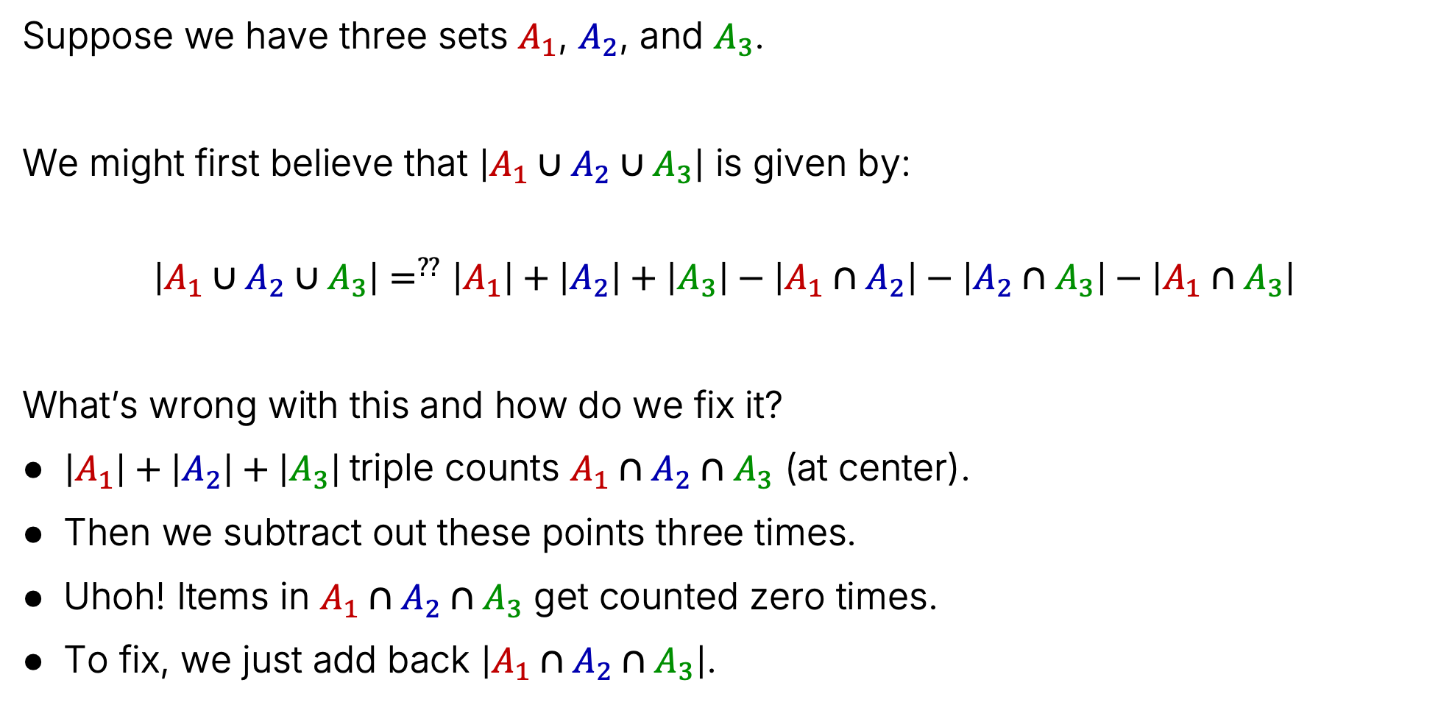
For Three Sets
Suppose we have three sets $A_{1}$, $A_{2}$, and $A_{3}$.
We might first believe that $\left|A_{1}∪A_{2}∪A_{3}\right|$ is given by:
$$\left|A_{1}∪A_{2}∪A_{3}\right|=^{??}\left|A_{1}\right|+\left|A_{2}\right|+\left|A_{3}\right|−\left|A_{1}∩A_{2}\right|−\left|A_{2}∩A_{3}\right|−\left|A_{1}∩A_{3}\right|$$
What’s wrong with this and how do we fix it?
$\left|A_{1}\right|+\left|A_{2}\right|+\left|A_{3}\right|$triple counts $A_{1}∩A_{2}∩A_{3}$ (at center).
Then we subtract out these points three times.
Uhoh! Items in $A_{1}∩A_{2}∩A_{3}$ get counted zero times.
To fix, we just add back $\left|A_{1}∩A_{2}∩A_{3}\right|$.

Slide 14
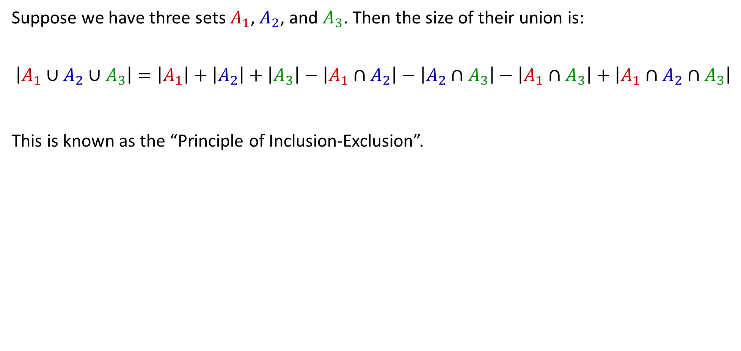
For Three Sets
Suppose we have three sets $A_{1}$, $A_{2}$, and $A_{3}$. Then the size of their union is:
$$\left|A_{1}∪A_{2}∪A_{3}\right|=\left|A_{1}\right|+\left|A_{2}\right|+\left|A_{3}\right|−\left|A_{1}∩A_{2}\right|−\left|A_{2}∩A_{3}\right|−\left|A_{1}∩A_{3}\right|+\left|A_{1}∩A_{2}∩A_{3}\right|$$
This is known as the “Principle of Inclusion-Exclusion”.

Slide 15
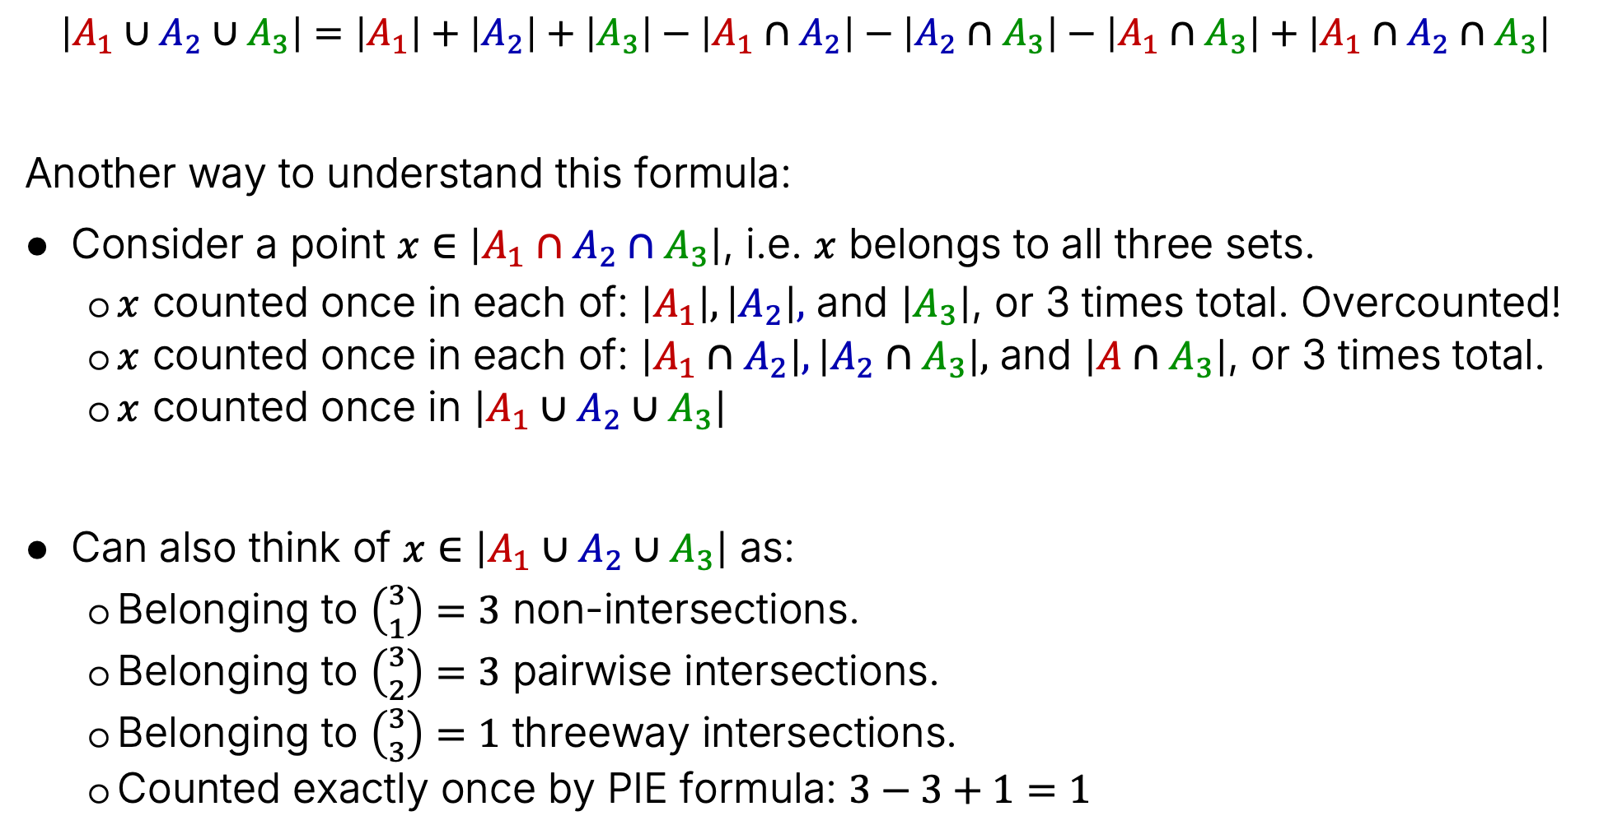
Alternate Justification for the PIE Formula
$$\left|A_{1}∪A_{2}∪A_{3}\right|=\left|A_{1}\right|+\left|A_{2}\right|+\left|A_{3}\right|−\left|A_{1}∩A_{2}\right|−\left|A_{2}∩A_{3}\right|−\left|A_{1}∩A_{3}\right|+\left|A_{1}∩A_{2}∩A_{3}\right|$$
Another way to understand this formula:
Consider a point $x∈\left|A_{1}∩A_{2}∩A_{3}\right|$, i.e. $x$ belongs to all three sets.
$x$ counted once in each of: $\left|A_{1}\right|, \left|A_{2}\right|,$ and $\left|A_{3}\right|$, or 3 times total. Overcounted!
$x$ counted once in each of: $\left|A_{1}∩A_{2}\right|, \left|A_{2}∩A_{3}\right|,$ and $\left|A∩A_{3}\right|$, or 3 times total.
$x$ counted once in $\left|A_{1}∪A_{2}∪A_{3}\right|$
Can also think of $x∈\left|A_{1}∪A_{2}∪A_{3}\right|$ as:
Belonging to $\left({3 \atop 1}\right)=3$ non-intersections.
Belonging to $\left({3 \atop 2}\right)=3$ pairwise intersections.
Belonging to $\left({3 \atop 3}\right)=1$ threeway intersections.
Counted exactly once by PIE formula: $3−3+1=1$

Slide 16
What if We Have Four Sets?
We can keep doing this. Without proof (yet), I offer the following procedure:
With four sets, we add all the sizes together.
But that results in an overcount, so we subtract out the sizes of the pairwise intersections.
But that results in an undercount, so we add back in the sizes of the three- way intersections.
But that results in an overcount, so we subtract the size of the four-way intersection.
$$\left|A_{1}∪A_{2}∪A_{3}∪A_{4}\right|=\left|A_{1}\right|+\left|A_{2}\right|+\left|A_{3}\right| +\left|A_{4}\right|$$
$$−\left(\left|A_{1}∩A_{2}\right|+\left|A_{1}∩A_{3}\right|+\left|A_{1}∩A_{4}\right| +\left|A_{2}∩A_{3}\right|+\left|A_{2}∩A_{4}\right|+\left|A_{3}∩A_{4}\right| \right)$$
$$+\left(\left|A_{1}∩A_{2}∩A_{3}\right|+\left|A_{1}∩A_{2}∩A_{4}\right|+\left|A_{1}∩A_{3}∩A_{4}\right|+\left|A_{2}∩A_{3}∩A_{4}\right|\right)$$
$$−\left(A_{1}∩A_{2}∩A_{3}∩A_{4}\right)$$

Slide 17
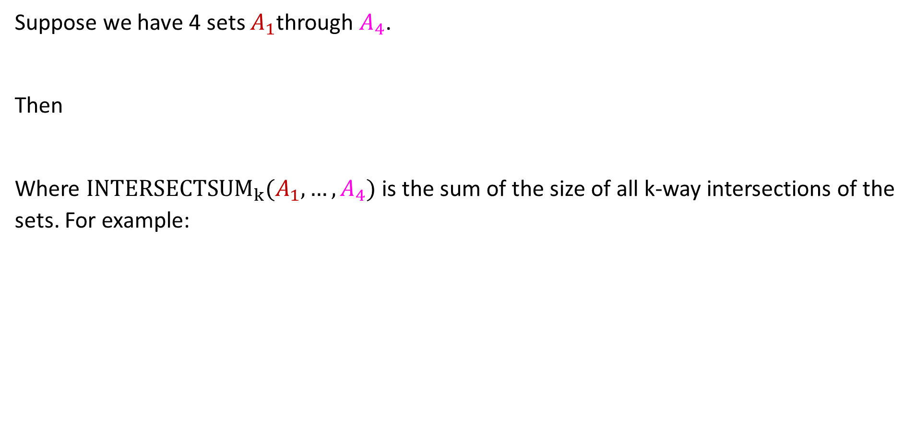
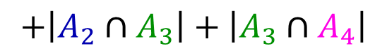
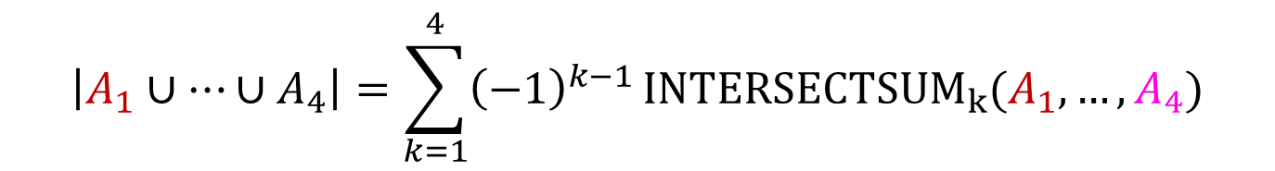
A More Compact Formula
Suppose we have 4 sets $A_{1}$through $A_{4}$.
Then
Where ${INTERSECTSUM}_{k}(A_{1},…,A_{4})$ is the sum of the size of all k-way intersections of the sets. For example:
$$\left|A_{1}∪…∪A_{4}\right|=\sum_{k=1}^{4}{{\left(−1\right)}^{k−1}}{INTERSECTSUM}_{k}(A_{1},…,A_{4})$$
${INTERSECTSUM}_{2}\left(A_{1},…,A_{4}\right)=\left|A_{1}∩A_{2}\right|+\left|A_{1}∩A_{3}\right|+\left|A_{1}∩A_{4}\right|$ $+\left|A_{2}∩A_{4}\right|$
$$+\left|A_{2}∩A_{3}\right|+\left|A_{3}∩A_{4}\right|$$
${INTERSECTSUM}_{3}\left(A_{1},…,A_{4}\right)=\left|A_{1}∩A_{2}∩A_{3}\right|+\left|A_{1}∩A_{2}∩A_{4}\right|+\left|A_{1}∩A_{3}∩A_{4}\right|$
Interesting design observation: Too much color!
$$+\left|A_{2}∩A_{3}∩A_{4}\right|$$

Slide 18
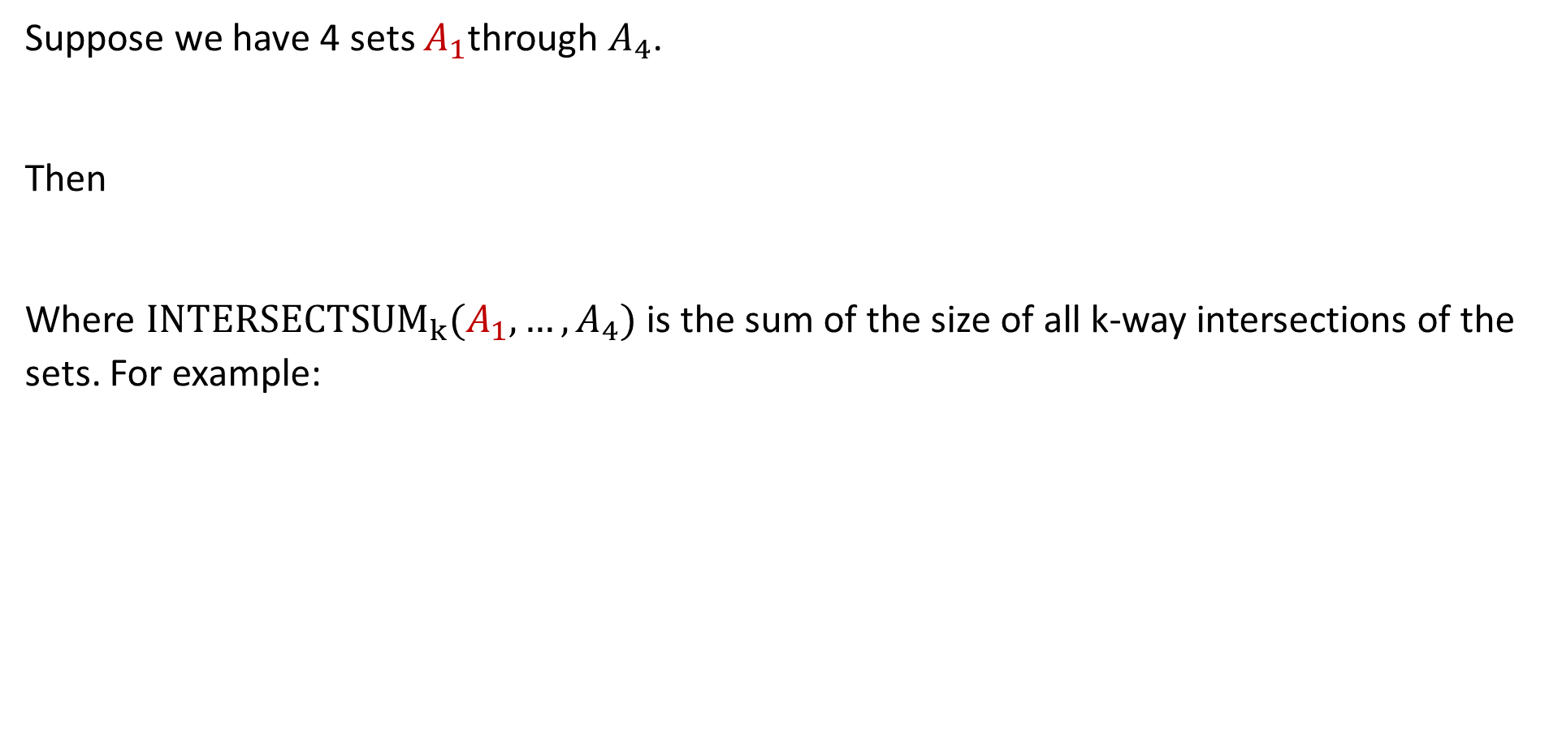
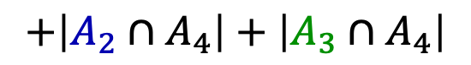
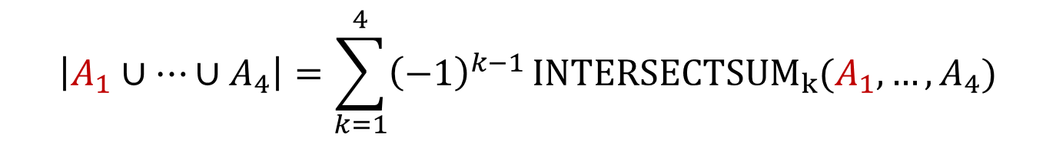
A More Compact Formula
Suppose we have 4 sets $A_{1}$through $A_{4}$.
Then
Where ${INTERSECTSUM}_{k}(A_{1},…,A_{4})$ is the sum of the size of all k-way intersections of the sets. For example:
$$\left|A_{1}∪…∪A_{4}\right|=\sum_{k=1}^{4}{{\left(−1\right)}^{k−1}}{INTERSECTSUM}_{k}(A_{1},…,A_{4})$$
${INTERSECTSUM}_{2}\left(A_{1},…,A_{4}\right)=\left|A_{1}∩A_{2}\right|+\left|A_{1}∩A_{3}\right|+\left|A_{1}∩A_{4}\right|$ $+\left|A_{2}∩A_{3}\right|$
$$+\left|A_{2}∩A_{4}\right|+\left|A_{3}∩A_{4}\right|$$
$$=\left|A_{1}∩A_{2}∩A_{3}\right|+\left|A_{1}∩A_{2}∩A_{4}\right|+\left|A_{1}∩A_{3}∩A_{4}\right|$$
${INTERSECTSUM}_{3}\left(A_{1},…,A_{4}\right)$
$$+\left|A_{2}∩A_{3}∩A_{4}\right|$$

Slide 19
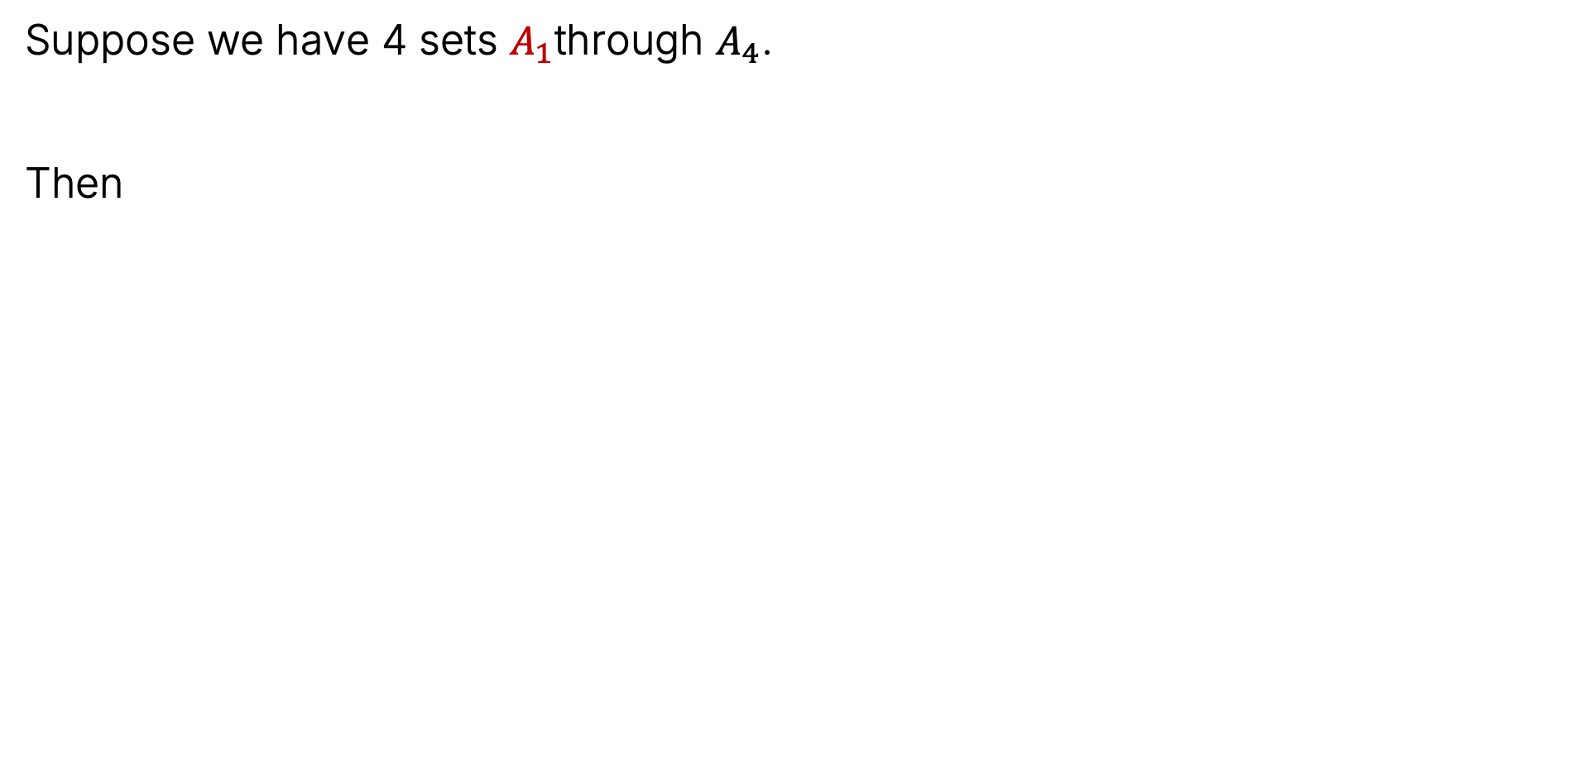
A More Compact Formula
Suppose we have 4 sets $A_{1}$through $A_{4}$.
Then
$$\left|A_{1}∪…∪A_{4}\right|=\sum_{k=1}^{4}{{\left(−1\right)}^{k−1}}{INTERSECTSUM}_{k}(A_{1},…,A_{4})$$
$$=\left|A_{1}\right|+\left|A_{2}\right|+\left|A_{3}\right| +\left|A_{4}\right|$$
$$−\left(\left|A_{1}∩A_{2}\right|+\left|A_{1}∩A_{3}\right|+\left|A_{1}∩A_{4}\right| +\left|A_{2}∩A_{3}\right|+\left|A_{2}∩A_{4}\right|+\left|A_{3}∩A_{4}\right| \right)$$
$$+\left(\left|A_{1}∩A_{2}∩A_{3}\right|+\left|A_{1}∩A_{2}∩A_{4}\right|+\left|A_{1}∩A_{3}∩A_{4}\right|+\left|A_{2}∩A_{3}∩A_{4}\right|\right)$$
$$−\left(A_{1}∩A_{2}∩A_{3}∩A_{4}\right)$$
We have not proven this yet! First, let’s generalize.

Slide 20
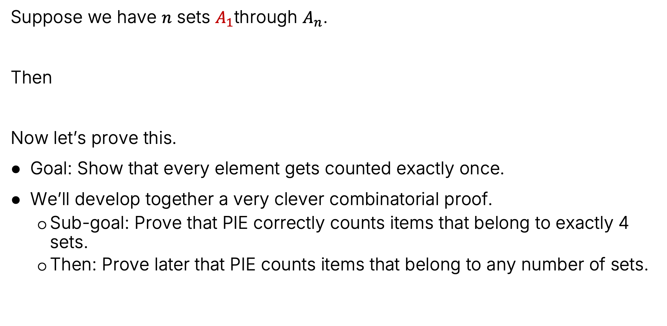
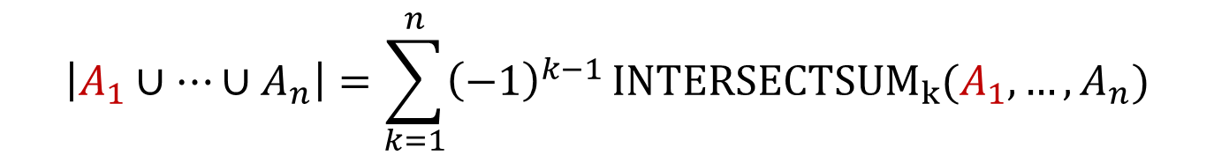
General PIE For Any Number of Sets
Suppose we have $n$ sets $A_{1}$through $A_{n}$.
Then
Now let’s prove this.
Goal: Show that every element gets counted exactly once.
We’ll develop together a very clever combinatorial proof.
Sub-goal: Prove that PIE correctly counts items that belong to exactly 4 sets.
Then: Prove later that PIE counts items that belong to any number of sets.
$$\left|A_{1}∪…∪A_{n}\right|=\sum_{k=1}^{n}{{\left(−1\right)}^{k−1}}{INTERSECTSUM}_{k}(A_{1},…,A_{n})$$

Slide 21
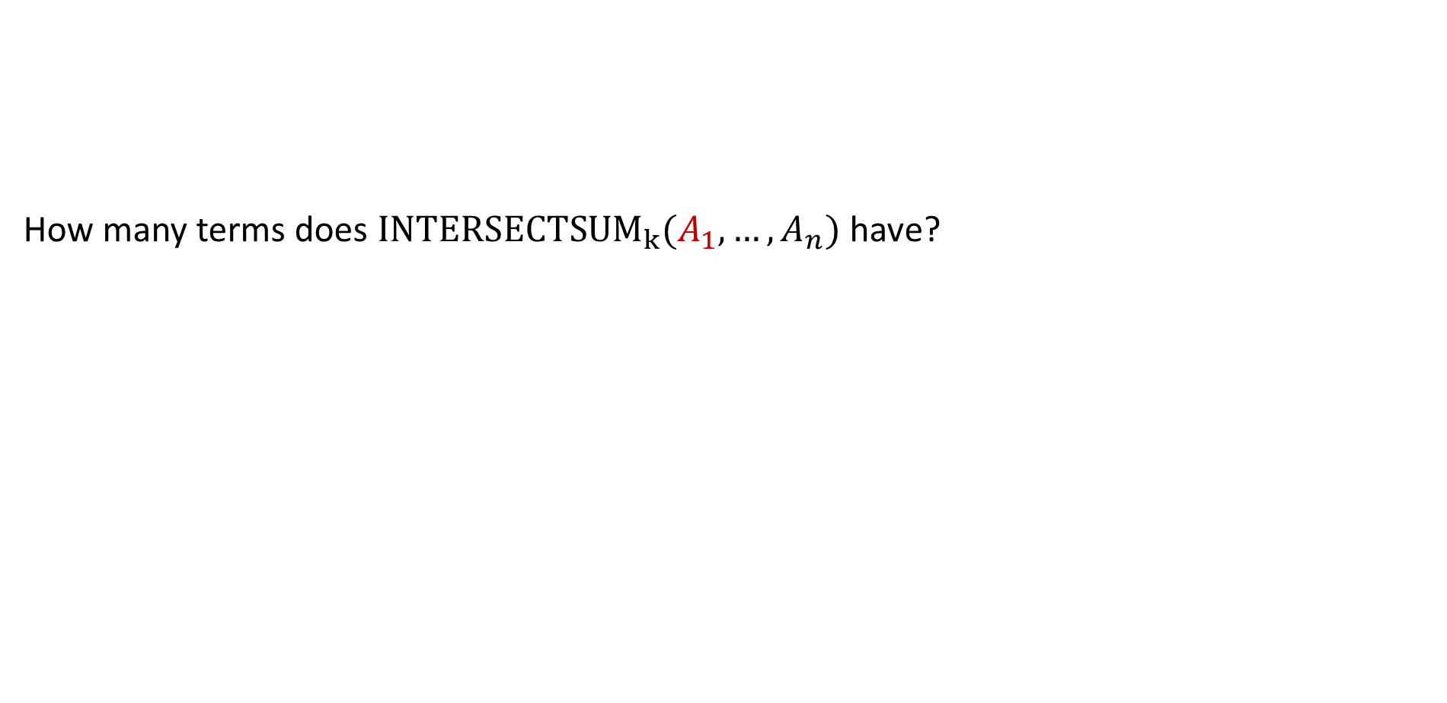
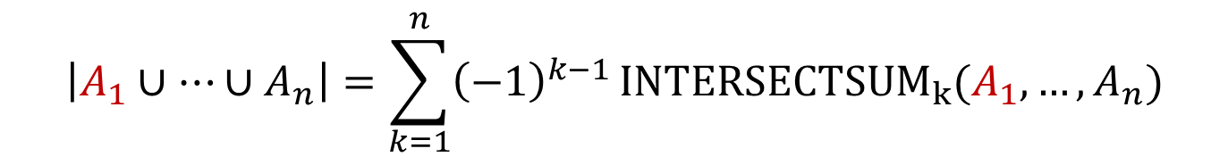
PIE Combinatorial Proof (Warmup Question)
How many terms does ${INTERSECTSUM}_{k}(A_{1},…,A_{n})$ have?
$$\left|A_{1}∪…∪A_{n}\right|=\sum_{k=1}^{n}{{\left(−1\right)}^{k−1}}{INTERSECTSUM}_{k}(A_{1},…,A_{n})$$

Slide 22

PIE Combinatorial Proof (Warmup Question)
How many terms does ${INTERSECTSUM}_{k}(A_{1},…,A_{n})$ have? $\left({n \atop k}\right)$
Example: If n = 4 and k = 2, we have:
$$\left|A_{1}∪…∪A_{n}\right|=\sum_{k=1}^{n}{{\left(−1\right)}^{k−1}}{INTERSECTSUM}_{k}(A_{1},…,A_{n})$$
$$\left|A_{1}∩A_{2}\right|+\left|A_{1}∩A_{3}\right|+\left|A_{1}∩A_{4}\right| +\left|A_{2}∩A_{3}\right|+\left|A_{2}∩A_{4}\right|+\left|A_{3}∩A_{4}\right|$$

Slide 23
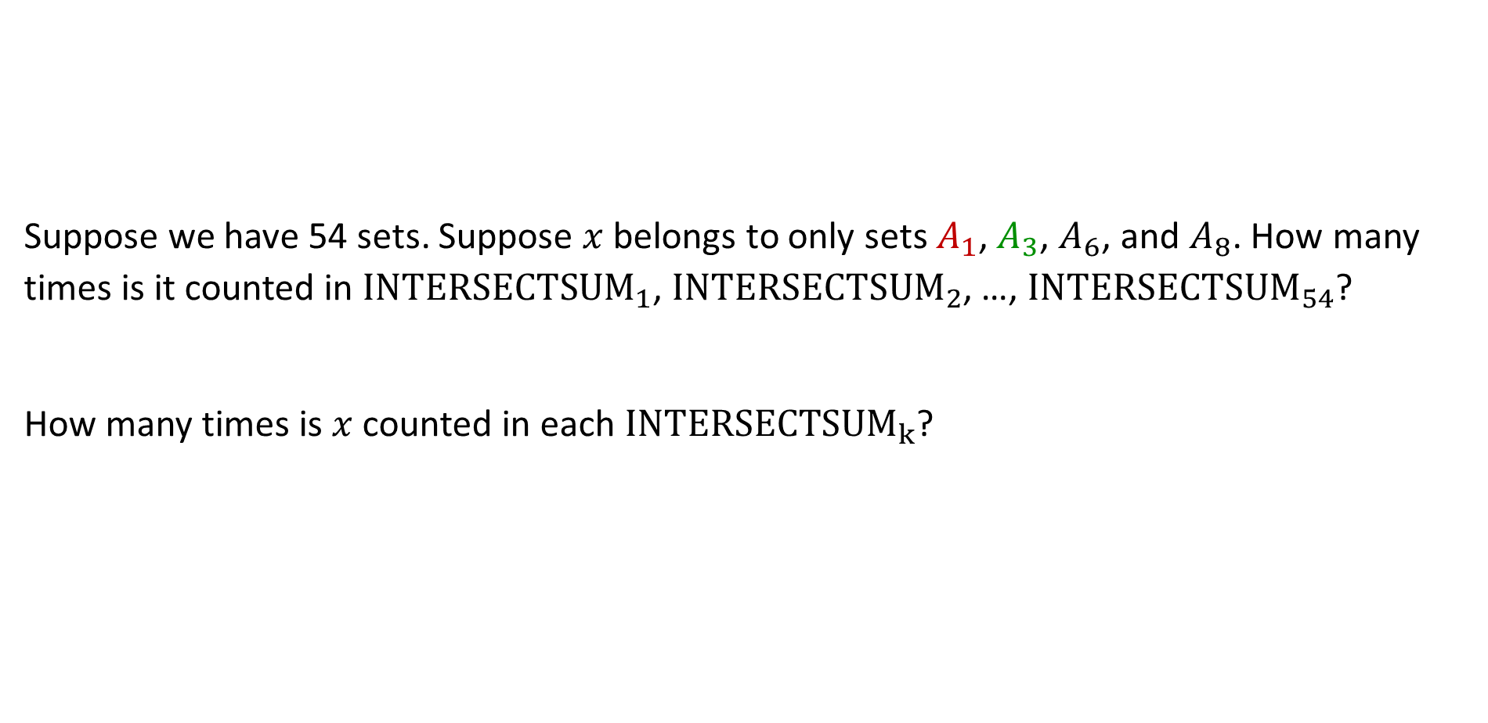
Proof that PIE Correctly Counts Items Belonging to 4 Sets
Suppose we have 54 sets. Suppose $x$ belongs to only sets $A_{1}$, $A_{3}$, $A_{6}$, and $A_{8}$. How many times is it counted in ${INTERSECTSUM}_{1}$, ${INTERSECTSUM}_{2}$, …, ${INTERSECTSUM}_{54}$?
How many times is $x$ counted in each ${INTERSECTSUM}_{k}$?
$$\left|A_{1}∪…∪A_{n}\right|=\sum_{k=1}^{n}{{\left(−1\right)}^{k−1}}{INTERSECTSUM}_{k}(A_{1},…,A_{n})$$

Slide 24
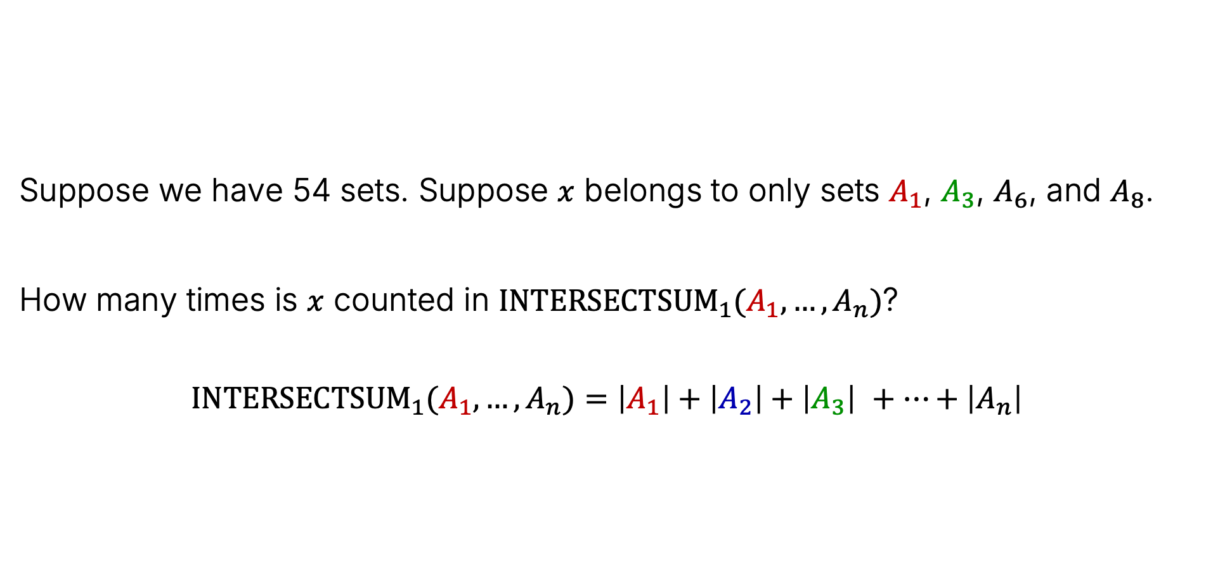
Proof that PIE Correctly Counts Items Belonging to 4 Sets
Suppose we have 54 sets. Suppose $x$ belongs to only sets $A_{1}$, $A_{3}$, $A_{6}$, and $A_{8}$.
How many times is $x$ counted in ${INTERSECTSUM}_{1}(A_{1},…,A_{n})$?
$${INTERSECTSUM}_{1}(A_{1},…,A_{n})=\left|A_{1}\right|+\left|A_{2}\right|+\left|A_{3}\right| +…+\left|A_{n}\right|$$
$$\left|A_{1}∪…∪A_{n}\right|=\sum_{k=1}^{n}{{\left(−1\right)}^{k−1}}{INTERSECTSUM}_{k}(A_{1},…,A_{n})$$

Slide 25
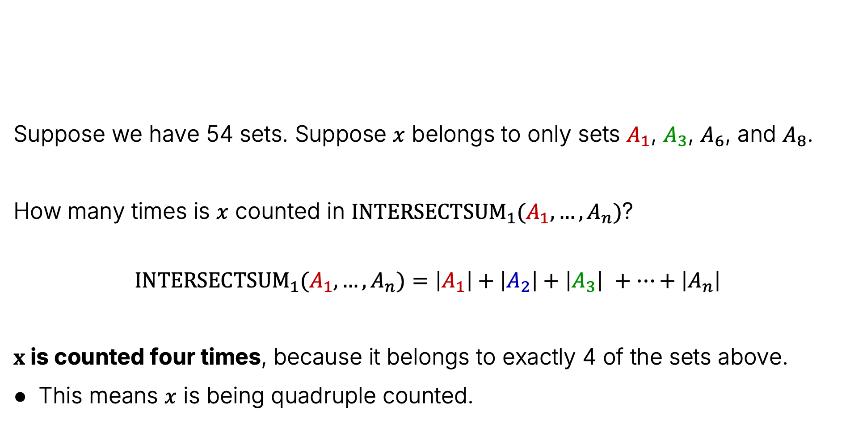
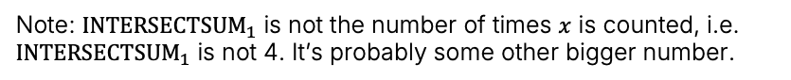
Proof that PIE Correctly Counts Items Belonging to 4 Sets
Suppose we have 54 sets. Suppose $x$ belongs to only sets $A_{1}$, $A_{3}$, $A_{6}$, and $A_{8}$.
How many times is $x$ counted in ${INTERSECTSUM}_{1}(A_{1},…,A_{n})$?
$${INTERSECTSUM}_{1}(A_{1},…,A_{n})=\left|A_{1}\right|+\left|A_{2}\right|+\left|A_{3}\right| +…+\left|A_{n}\right|$$
$x$ is counted four times, because it belongs to exactly 4 of the sets above.
This means $x$ is being quadruple counted.
$$\left|A_{1}∪…∪A_{n}\right|=\sum_{k=1}^{n}{{\left(−1\right)}^{k−1}}{INTERSECTSUM}_{k}(A_{1},…,A_{n})$$
Note: ${INTERSECTSUM}_{1}$ is not the number of times $x$ is counted, i.e. ${INTERSECTSUM}_{1}$ is not 4. It’s probably some other bigger number.

Slide 26
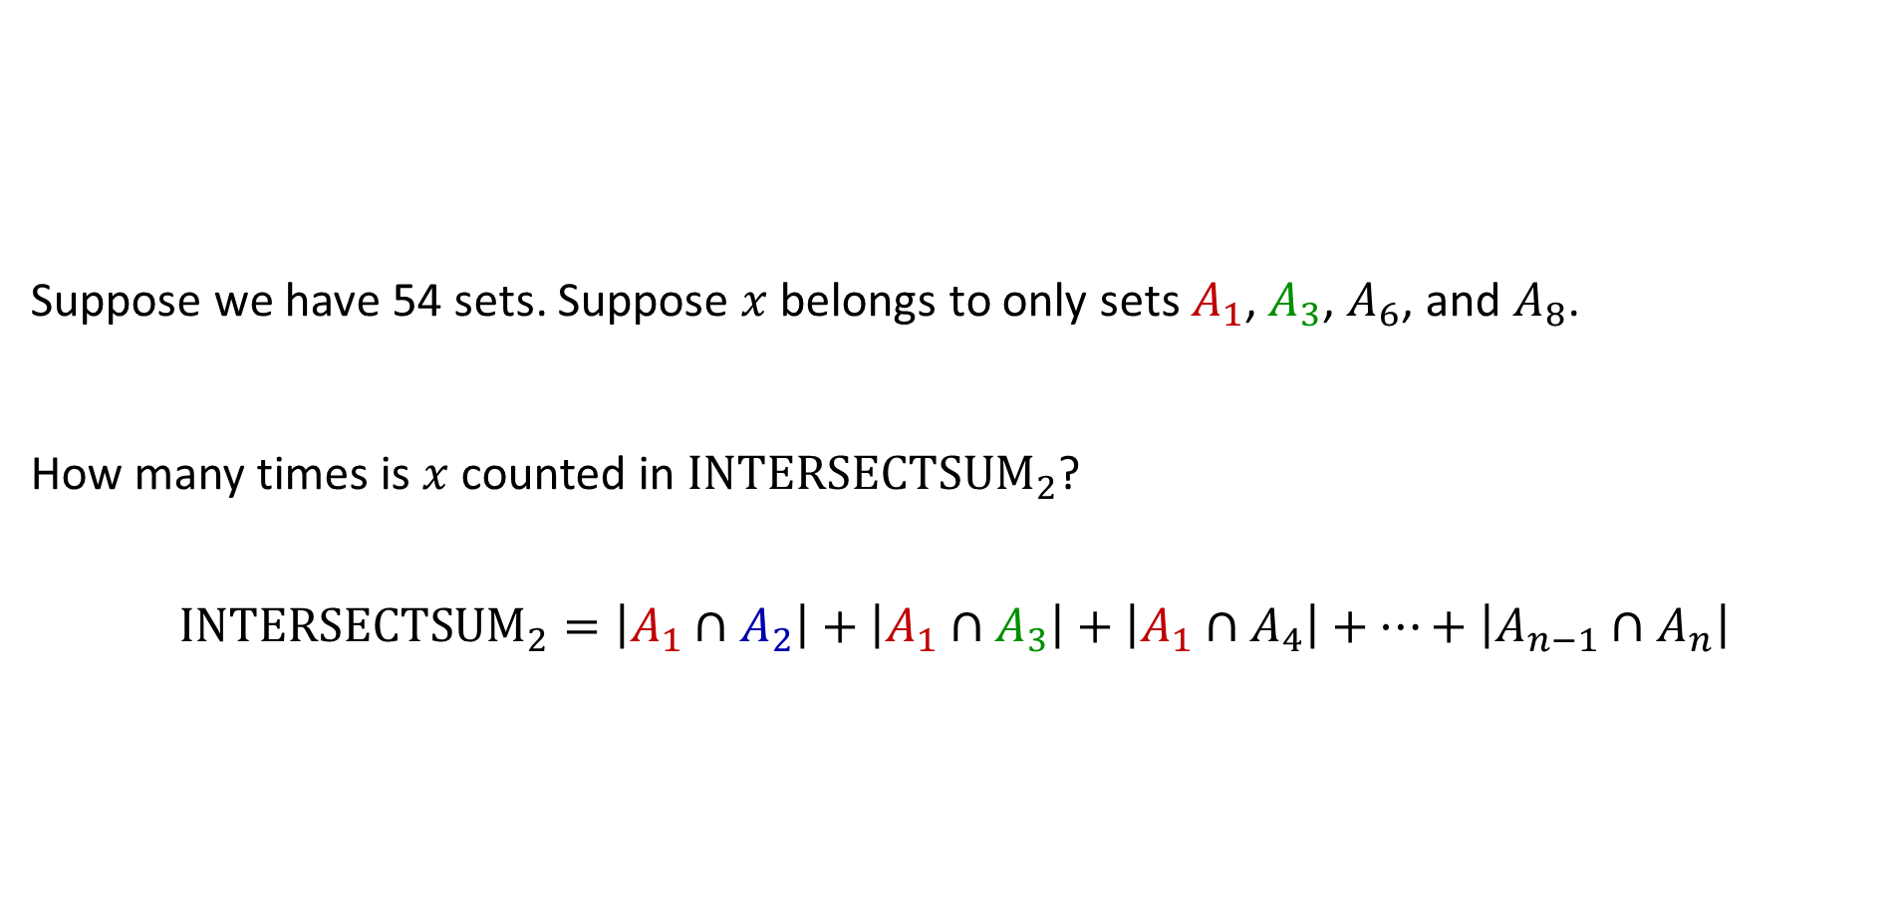

Proof that PIE Correctly Counts Items Belonging to 4 Sets
Suppose we have 54 sets. Suppose $x$ belongs to only sets $A_{1}$, $A_{3}$, $A_{6}$, and $A_{8}$.
How many times is $x$ counted in ${INTERSECTSUM}_{2}$?
$${INTERSECTSUM}_{2}=\left|A_{1}∩A_{2}\right|+\left|A_{1}∩A_{3}\right|+\left|A_{1}∩A_{4}\right|+…+\left|A_{n−1}∩A_{n}\right|$$
$$\left|A_{1}∪…∪A_{n}\right|=\sum_{k=1}^{n}{{\left(−1\right)}^{k−1}}{INTERSECTSUM}_{k}(A_{1},…,A_{n})$$
Note: To avoid wasting space, the following slides say ${INTERSECTSUM}_{k}$ instead of ${INTERSECTSUM}_{k}(A_{1},…,A_{n})$

Slide 27
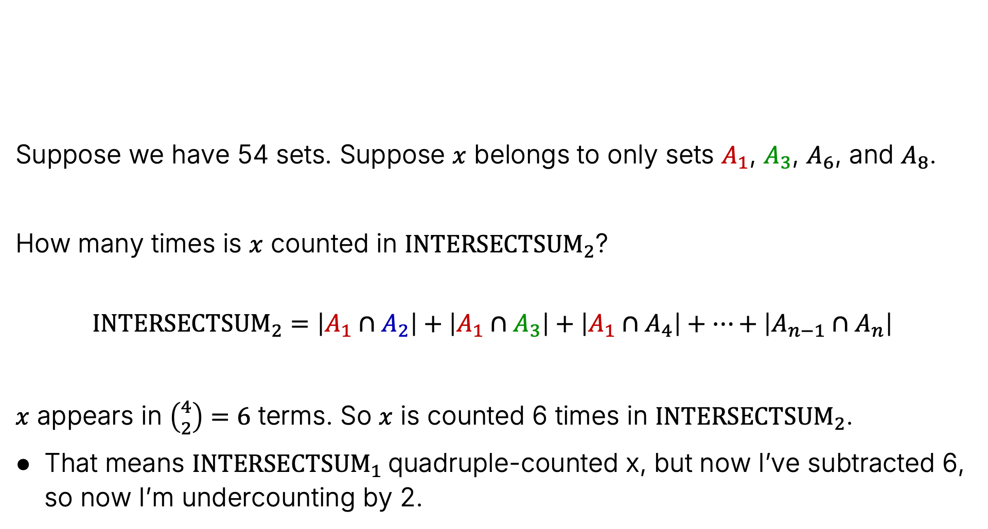
Proof that PIE Correctly Counts Items Belonging to 4 Sets
Suppose we have 54 sets. Suppose $x$ belongs to only sets $A_{1}$, $A_{3}$, $A_{6}$, and $A_{8}$.
How many times is $x$ counted in ${INTERSECTSUM}_{2}$?
$${INTERSECTSUM}_{2}=\left|A_{1}∩A_{2}\right|+\left|A_{1}∩A_{3}\right|+\left|A_{1}∩A_{4}\right|+…+\left|A_{n−1}∩A_{n}\right|$$
$x$ appears in $\left({4 \atop 2}\right)=6$ terms. So $x$ is counted 6 times in ${INTERSECTSUM}_{2}$.
That means ${INTERSECTSUM}_{1}$quadruple-counted x, but now I’ve subtracted 6, so now I’m undercounting by 2.
$$\left|A_{1}∪…∪A_{n}\right|=\sum_{k=1}^{n}{{\left(−1\right)}^{k−1}}{INTERSECTSUM}_{k}(A_{1},…,A_{n})$$

Slide 28
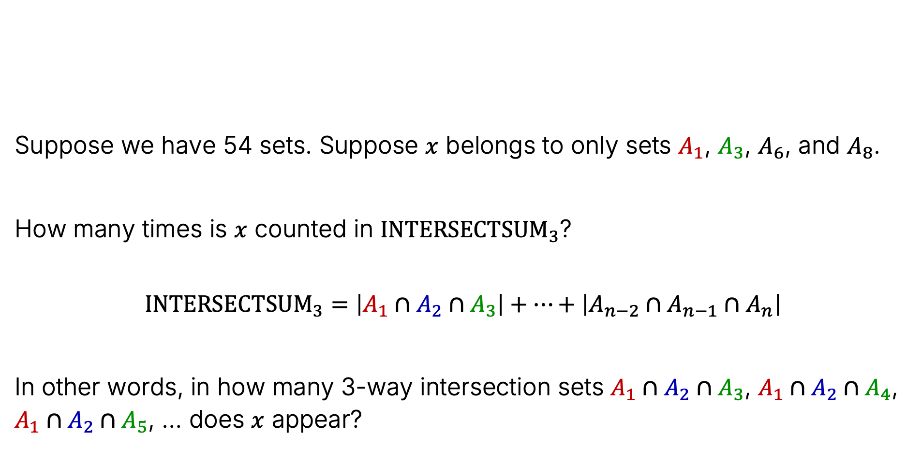
Proof that PIE Correctly Counts Items Belonging to 4 Sets
Suppose we have 54 sets. Suppose $x$ belongs to only sets $A_{1}$, $A_{3}$, $A_{6}$, and $A_{8}$.
How many times is $x$ counted in ${INTERSECTSUM}_{3}$?
$${INTERSECTSUM}_{3}=\left|A_{1}∩A_{2}∩A_{3}\right|+…+\left|{A_{n−2}∩A}_{n−1}∩A_{n}\right|$$
In other words, in how many 3-way intersection sets $A_{1}∩A_{2}∩A_{3}$, $A_{1}∩A_{2}∩A_{4}$, $A_{1}∩A_{2}∩A_{5}$, … does $x$ appear?
$$\left|A_{1}∪…∪A_{n}\right|=\sum_{k=1}^{n}{{\left(−1\right)}^{k−1}}{INTERSECTSUM}_{k}(A_{1},…,A_{n})$$

Slide 29
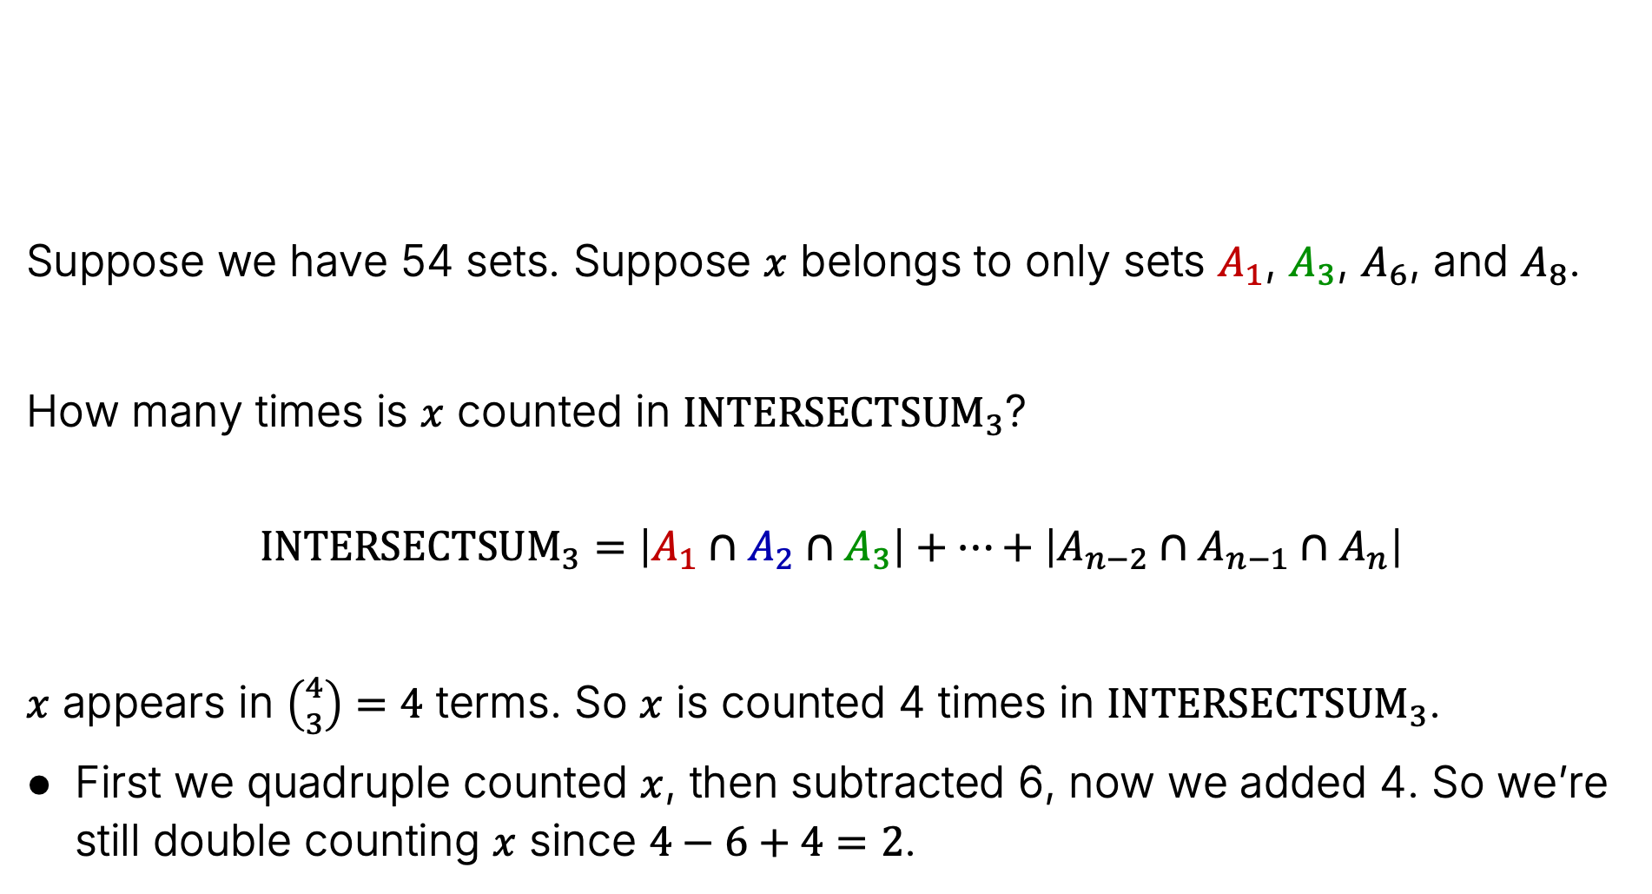
Proof that PIE Correctly Counts Items Belonging to 4 Sets
Suppose we have 54 sets. Suppose $x$ belongs to only sets $A_{1}$, $A_{3}$, $A_{6}$, and $A_{8}$.
How many times is $x$ counted in ${INTERSECTSUM}_{3}$?
$${INTERSECTSUM}_{3}=\left|A_{1}∩A_{2}∩A_{3}\right|+…+\left|{A_{n−2}∩A}_{n−1}∩A_{n}\right|$$
$x$ appears in $\left({4 \atop 3}\right)=4$ terms. So $x$ is counted 4 times in ${INTERSECTSUM}_{3}$.
First we quadruple counted $x$, then subtracted 6, now we added 4. So we’re still double counting $x$ since $4−6+4=2$.
$$\left|A_{1}∪…∪A_{n}\right|=\sum_{k=1}^{n}{{\left(−1\right)}^{k−1}}{INTERSECTSUM}_{k}(A_{1},…,A_{n})$$

Slide 30
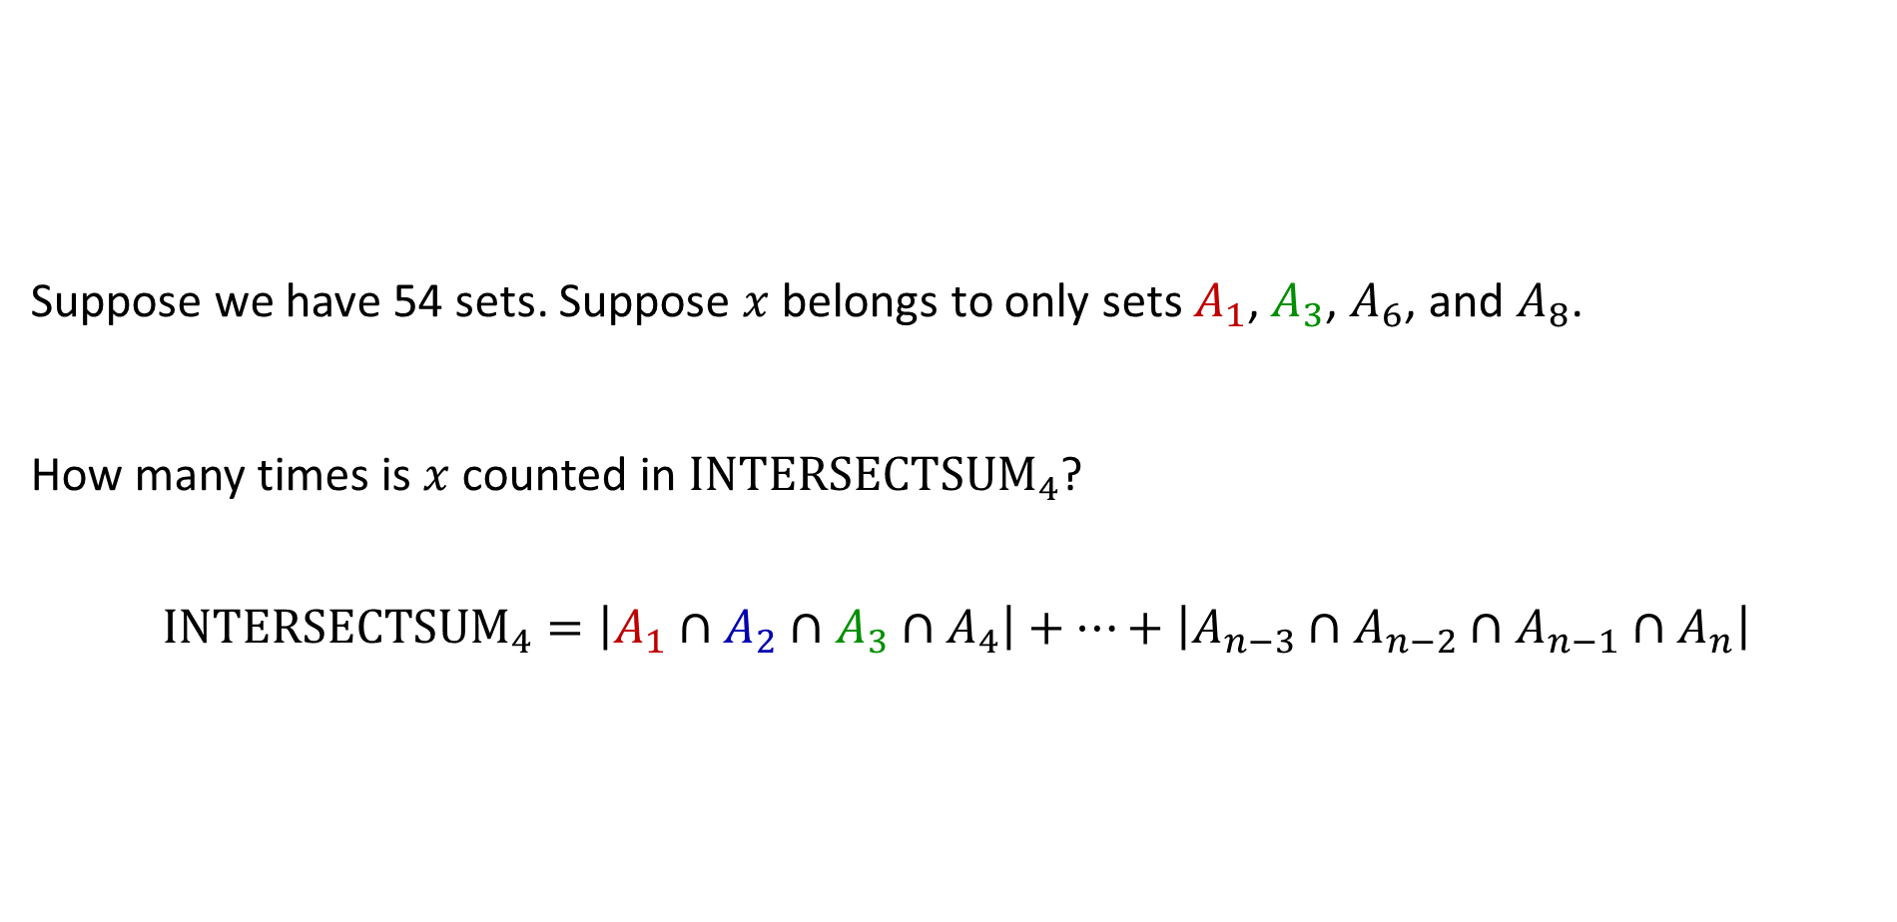
Proof that PIE Correctly Counts Items Belonging to 4 Sets
Suppose we have 54 sets. Suppose $x$ belongs to only sets $A_{1}$, $A_{3}$, $A_{6}$, and $A_{8}$.
How many times is $x$ counted in ${INTERSECTSUM}_{4}$?
$${INTERSECTSUM}_{4}=\left|A_{1}∩A_{2}∩A_{3}∩A_{4}\right|+…+\left|{{A_{n−3}∩A}_{n−2}∩A}_{n−1}∩A_{n}\right|$$
$$\left|A_{1}∪…∪A_{n}\right|=\sum_{k=1}^{n}{{\left(−1\right)}^{k−1}}{INTERSECTSUM}_{k}(A_{1},…,A_{n})$$

Slide 31
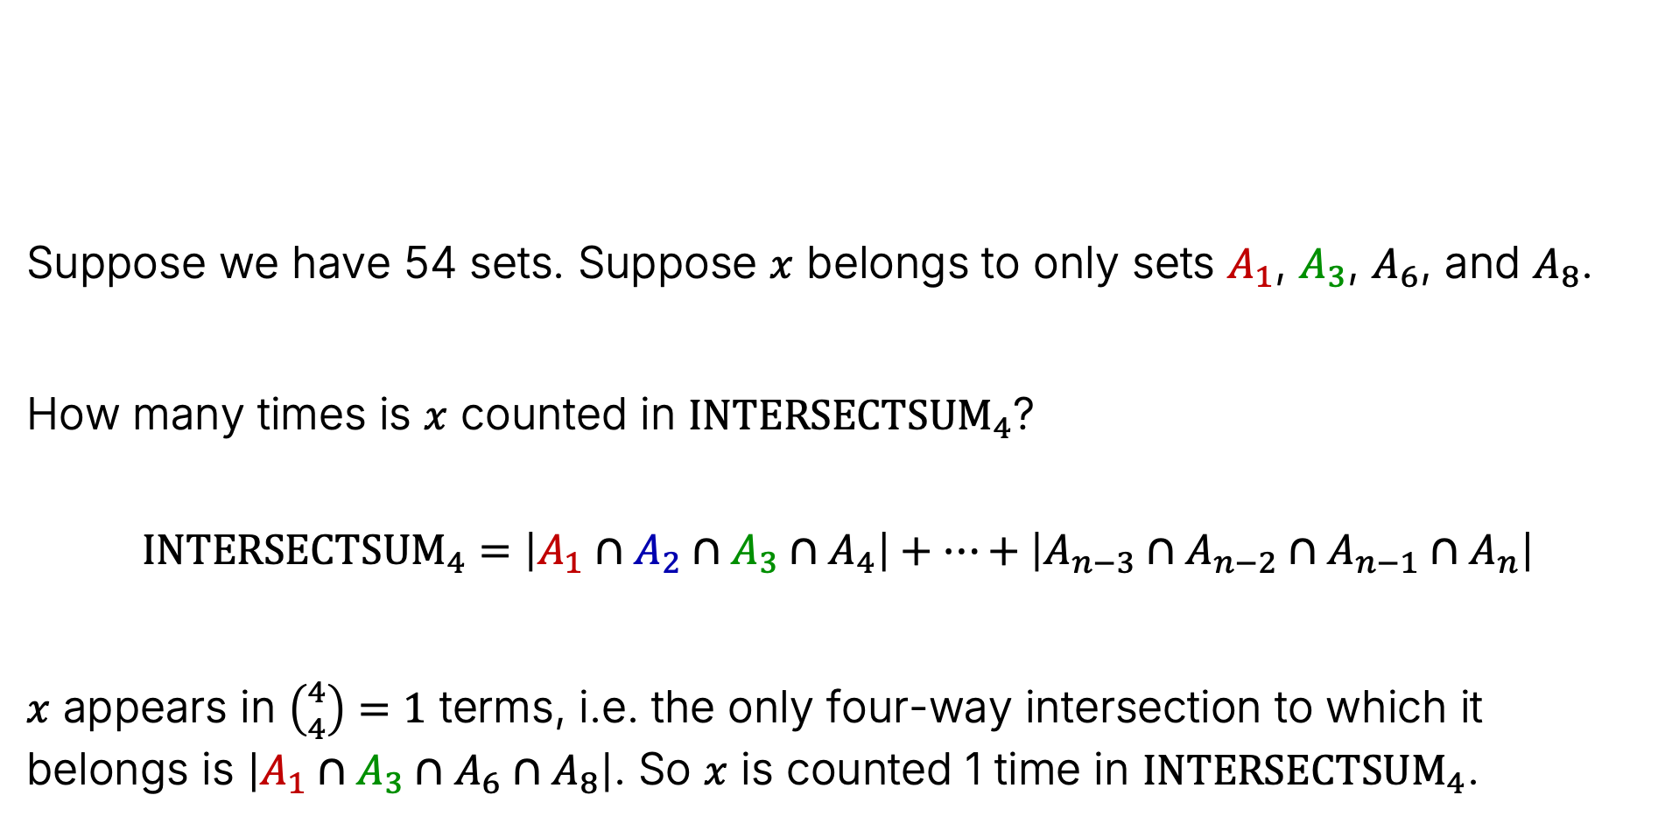
Proof that PIE Correctly Counts Items Belonging to 4 Sets
Suppose we have 54 sets. Suppose $x$ belongs to only sets $A_{1}$, $A_{3}$, $A_{6}$, and $A_{8}$.
How many times is $x$ counted in ${INTERSECTSUM}_{4}$?
$${INTERSECTSUM}_{4}=\left|A_{1}∩A_{2}∩A_{3}∩A_{4}\right|+…+\left|{{A_{n−3}∩A}_{n−2}∩A}_{n−1}∩A_{n}\right|$$
$x$ appears in $\left({4 \atop 4}\right)=1$ terms, i.e. the only four-way intersection to which it belongs is $\left|A_{1}∩A_{3}∩A_{6}∩A_{8}\right|$. So $x$ is counted 1 time in ${INTERSECTSUM}_{4}$.
$$\left|A_{1}∪…∪A_{n}\right|=\sum_{k=1}^{n}{{\left(−1\right)}^{k−1}}{INTERSECTSUM}_{k}(A_{1},…,A_{n})$$

Slide 32
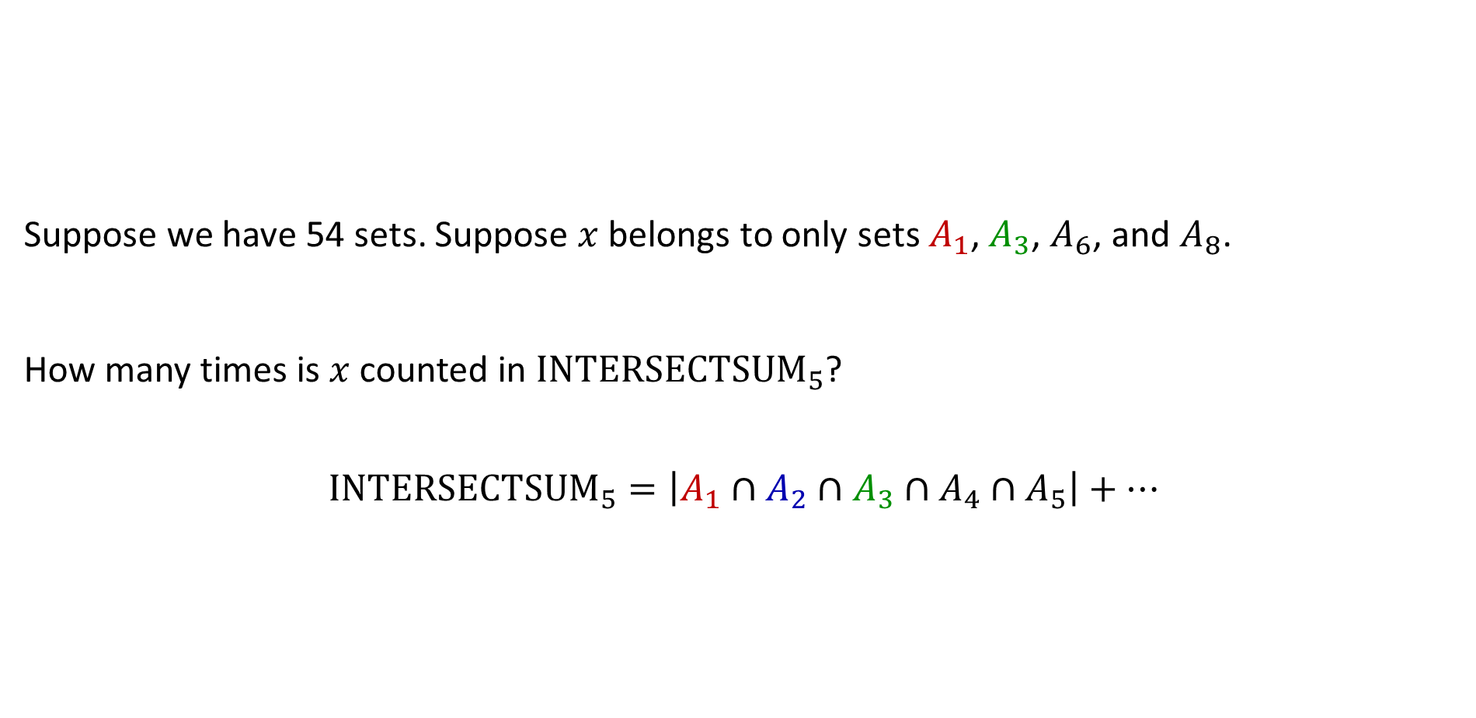
Proof that PIE Correctly Counts Items Belonging to 4 Sets
Suppose we have 54 sets. Suppose $x$ belongs to only sets $A_{1}$, $A_{3}$, $A_{6}$, and $A_{8}$.
How many times is $x$ counted in ${INTERSECTSUM}_{5}$?
$${INTERSECTSUM}_{5}=\left|A_{1}∩A_{2}∩A_{3}∩A_{4}∩A_{5}\right|+…$$
$$\left|A_{1}∪…∪A_{n}\right|=\sum_{k=1}^{n}{{\left(−1\right)}^{k−1}}{INTERSECTSUM}_{k}(A_{1},…,A_{n})$$

Slide 33
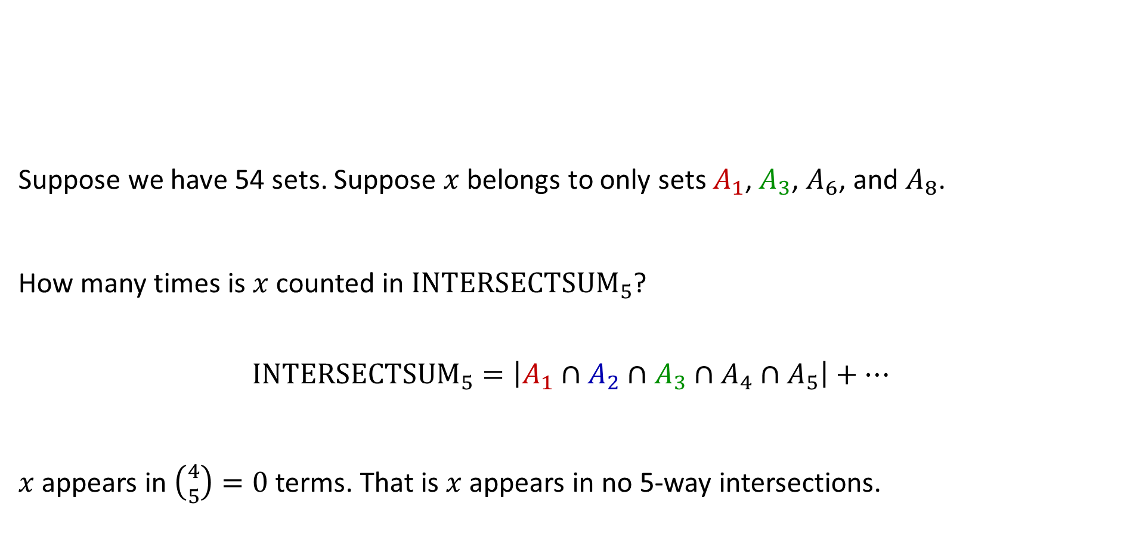
Proof that PIE Correctly Counts Items Belonging to 4 Sets
Suppose we have 54 sets. Suppose $x$ belongs to only sets $A_{1}$, $A_{3}$, $A_{6}$, and $A_{8}$.
How many times is $x$ counted in ${INTERSECTSUM}_{5}$?
$${INTERSECTSUM}_{5}=\left|A_{1}∩A_{2}∩A_{3}∩A_{4}∩A_{5}\right|+…$$
$x$ appears in $\left({4 \atop 5}\right)=0$ terms. That is $x$ appears in no 5-way intersections.
$$\left|A_{1}∪…∪A_{n}\right|=\sum_{k=1}^{n}{{\left(−1\right)}^{k−1}}{INTERSECTSUM}_{k}(A_{1},…,A_{n})$$

Slide 34
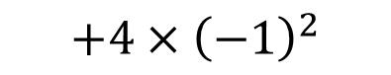

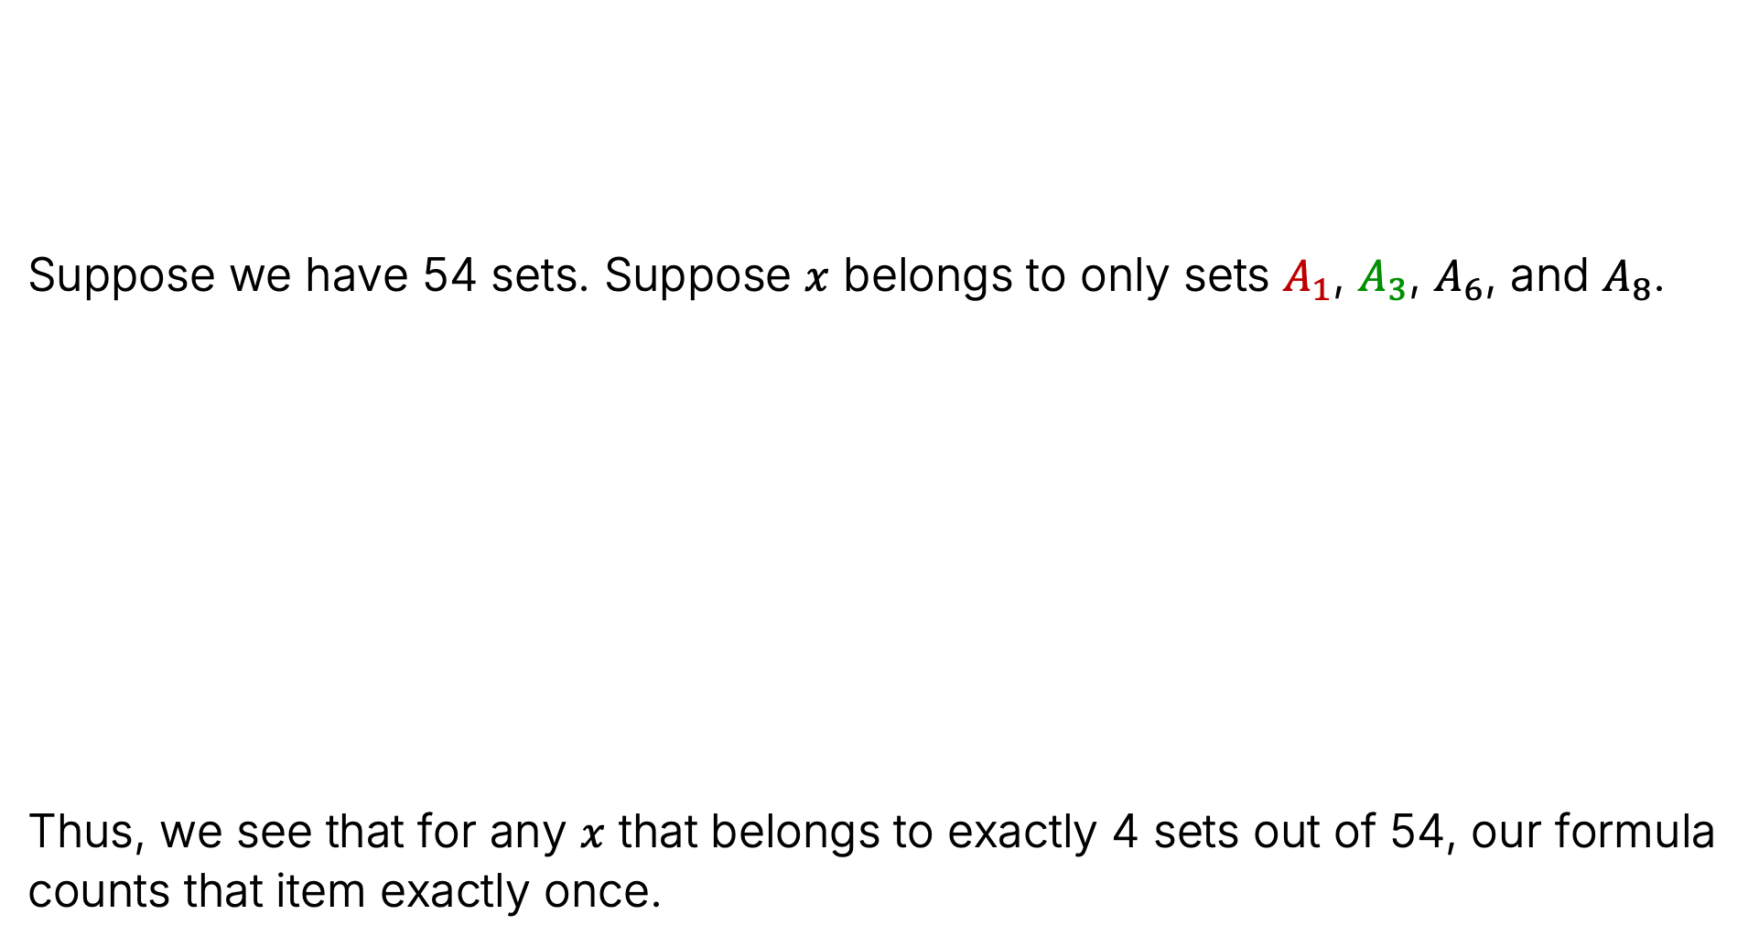




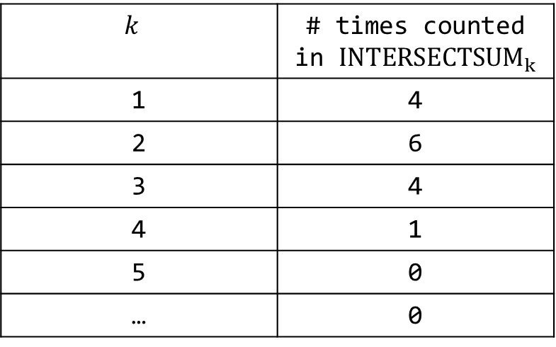

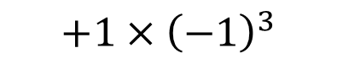
Proof that PIE Correctly Counts Items Belonging to 4 Sets
Suppose we have 54 sets. Suppose $x$ belongs to only sets $A_{1}$, $A_{3}$, $A_{6}$, and $A_{8}$.
Thus, we see that for any $x$ that belongs to exactly 4 sets out of 54, our formula counts that item exactly once.
$$\left|A_{1}∪…∪A_{n}\right|=\sum_{k=1}^{n}{{\left(−1\right)}^{k−1}}{INTERSECTSUM}_{k}(A_{1},…,A_{n})$$
$$k$$ | # times counted in ${INTERSECTSUM}_{k}$
1 | 4
2 | 6
3 | 4
4 | 1
5 | 0
… | 0
$$4×{\left(−1\right)}^{0}$$
$$4$$
$$+6×{\left(−1\right)}^{1}$$
$$−6$$
$$+4×{\left(−1\right)}^{2}$$
$$+4$$
$$+1×{\left(−1\right)}^{3}$$
$$−1$$

Slide 35
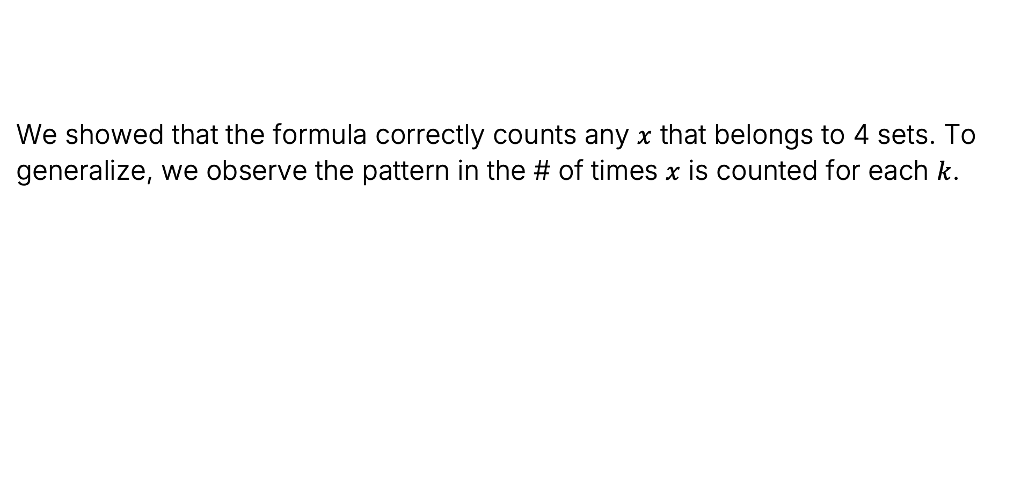
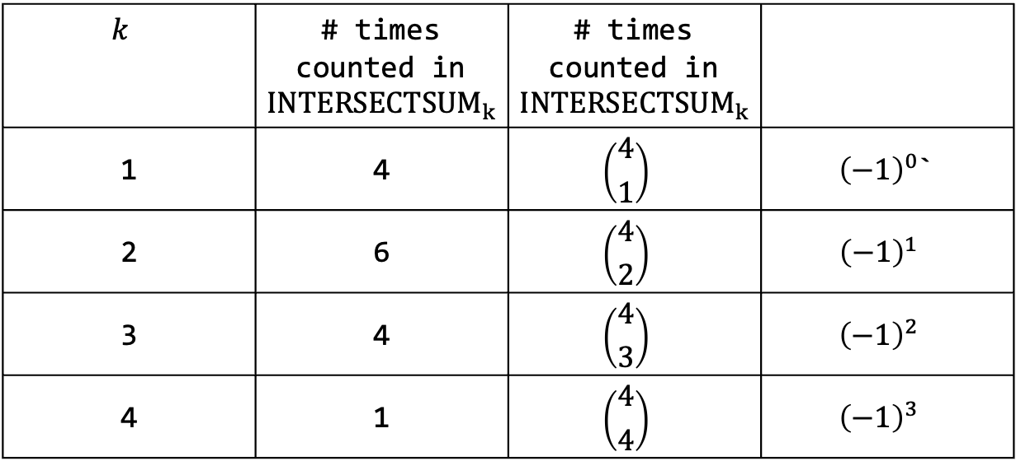
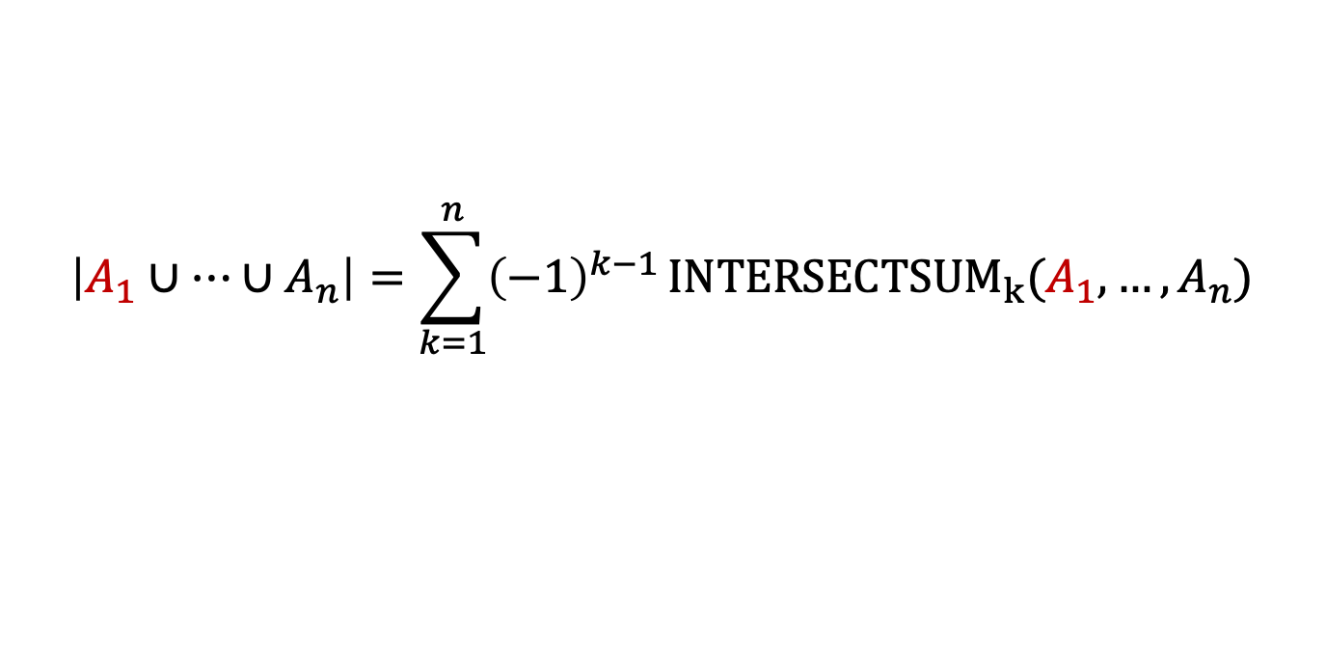
PIE Combinatorial Proof
We showed that the formula correctly counts any $x$ that belongs to 4 sets. To generalize, we observe the pattern in the # of times $x$ is counted for each $k$.
$$\left|A_{1}∪…∪A_{n}\right|=\sum_{k=1}^{n}{{\left(−1\right)}^{k−1}}{INTERSECTSUM}_{k}(A_{1},…,A_{n})$$
$$k$$ | # times counted in ${INTERSECTSUM}_{k}$ | # times counted in ${INTERSECTSUM}_{k}$
1 | 4 | $$\left({4 \atop 1}\right)$$ | ${\left(−1\right)}^{0}$`
2 | 6 | $$\left({4 \atop 2}\right)$$ | $${\left(−1\right)}^{1}$$
3 | 4 | $$\left({4 \atop 3}\right)$$ | $${\left(−1\right)}^{2}$$
4 | 1 | $$\left({4 \atop 4}\right)$$ | $${\left(−1\right)}^{3}$$
Table for an item where $x$ belongs to 4 sets

Slide 36




PIE Combinatorial Proof
Suppose $x$ belongs to $m$ sets. Then the number of times $x$ will be counted is:
We saw before that if we pick $m=4$, we get $4−6+4−1$.
If you pick $m=5$, we get
This means that if an item belong to exactly 5 sets, it also gets counted correctly.
$$\left|A_{1}∪…∪A_{n}\right|=\sum_{k=1}^{n}{{\left(−1\right)}^{k−1}}{INTERSECTSUM}_{k}(A_{1},…,A_{n})$$
$$\left({m \atop 1}\right)−\left({m \atop 2}\right)+\left({m \atop 3}\right)−\left({m \atop 4}\right)+…+\left({m \atop m}\right){\left(−1\right)}^{m−1}$$
$$\left({5 \atop 1}\right)−\left({5 \atop 2}\right)+\left({5 \atop 3}\right)−\left({5 \atop 4}\right)+\left({5 \atop 5}\right)$$
$$=5−10+10−5+1=1$$

Slide 37


PIE Combinatorial Proof
Suppose $x$ belongs to $m$ sets. Then the number of times $x$ will be counted is:
To prove the PIE in general, we have to show that this sum equals 1 for all $m$.
Let’s see a VERY clever way to prove this using the binomial theorem.
This is well beyond the scope of what we would expect you to figure out on your own.
$$\left|A_{1}∪…∪A_{n}\right|=\sum_{k=1}^{n}{{\left(−1\right)}^{k−1}}{INTERSECTSUM}_{k}(A_{1},…,A_{n})$$
$$\left({m \atop 1}\right)−\left({m \atop 2}\right)+\left({m \atop 3}\right)−\left({m \atop 4}\right)+…+\left({m \atop m}\right){\left(−1\right)}^{m−1}$$
$${\left(a+b\right)}^{n}=\sum_{k=0}^{n}{\left({n \atop k}\right)a^{n−k}b^{k}}$$
Seems unrelated.

Slide 38



Side-Quest: The Binomial Theorem for $a=1, b=−1$
Suppose we plug in $a=1$, $b=−1$ into the binomial theorem.
What number does the binomial theorem yield? LHS gives us 0 trivially.
That means the RHS is also 0 if we plug in $a=1$, $b=−1$:
$${\left(a+b\right)}^{n}=\sum_{k=0}^{n}{\left({n \atop k}\right)a^{n−k}b^{k}}$$
$${\left(a+b\right)}^{n}={\left(1−1\right)}^{n}=0^{n}=0$$
$$0=\sum_{k=0}^{n}{\left({n \atop k}\right){\left(−1\right)}^{k}}$$

Slide 39


Side-Quest: The Binomial Theorem for $a=1, b=−1$
Suppose we plug in $a=1$, $b=−1$ into the binomial theorem.
What number does the binomial theorem yield? LHS gives us 0 trivially.
That means the RHS is also 0 if we plug in $a=1$, $b=−1$:
$${\left(a+b\right)}^{n}=\sum_{k=0}^{n}{\left({n \atop k}\right)a^{n−k}b^{k}}$$
$${\left(a+b\right)}^{n}={\left(1−1\right)}^{n}=0^{n}=0$$
$$0=\sum_{k=0}^{n}{\left({n \atop k}\right){\left(−1\right)}^{k}=\left({n \atop 0}\right){\left(−1\right)}^{0}}+\left({n \atop 1}\right){\left(−1\right)}^{1}+\left({n \atop 2}\right){\left(−1\right)}^{2}…+\left({n \atop n}\right){\left(−1\right)}^{n}$$
Let’s toss even powers of -1 and convert odd powers of -1 to minus signs.

Slide 40


Side-Quest: The Binomial Theorem for $a=1, b=−1$
Suppose we plug in $a=1$, $b=−1$ into the binomial theorem.
What number does the binomial theorem yield? LHS gives us 0 trivially.
That means the RHS is also 0:
$${\left(a+b\right)}^{n}=\sum_{k=0}^{n}{\left({n \atop k}\right)a^{n−k}b^{k}}$$
$${\left(a+b\right)}^{n}={\left(1−1\right)}^{n}=0^{n}=0$$
$$0=\sum_{k=0}^{n}{\left({n \atop k}\right){\left(−1\right)}^{k}=\left({n \atop 0}\right)}−\left({n \atop 1}\right)+\left({n \atop 2}\right)−\left({n \atop 3}\right)…+\left({n \atop n}\right){\left(−1\right)}^{n}$$
Didn’t toss/convert last one because we don’t know if even or odd.

Slide 41
Side-Quest: The Binomial Theorem for $a=1, b=−1$
Suppose we plug in $a=1$, $b=−1$ into the binomial theorem.
What number does the binomial theorem yield? LHS gives us 0 trivially.
That means the RHS is also 0:
$${\left(a+b\right)}^{n}=\sum_{k=0}^{n}{\left({n \atop k}\right)a^{n−k}b^{k}}$$
$${\left(a+b\right)}^{n}={\left(1−1\right)}^{n}=0^{n}=0$$
$$0=\left({n \atop 0}\right)−\left({n \atop 1}\right)+\left({n \atop 2}\right)−…+\left({n \atop n}\right){\left(−1\right)}^{n}$$

Slide 42

Side-Quest: The Binomial Theorem for $a=1, b=−1$
Suppose we plug in $a=1$, $b=−1$ into the binomial theorem.
What number does the binomial theorem yield? LHS gives us 0 trivially.
That means the RHS is also 0:
We’re close. What is $\left({n \atop 0}\right)$?
$${\left(a+b\right)}^{n}=\sum_{k=0}^{n}{\left({n \atop k}\right)a^{n−k}b^{k}}$$
$${\left(a+b\right)}^{n}={\left(1−1\right)}^{n}=0^{n}=0$$
$$0=\left({n \atop 0}\right)−\left({n \atop 1}\right)+\left({n \atop 2}\right)−…+\left({n \atop n}\right){\left(−1\right)}^{n}$$

Slide 43

Side-Quest: The Binomial Theorem for $a=1, b=−1$
Suppose we plug in $a=1$, $b=−1$ into the binomial theorem.
What number does the binomial theorem yield? LHS gives us 0 trivially.
That means the RHS is also 0:
We’re close. What is $\left({n \atop 0}\right)$? 1, there is one way to choose nothing.
$${\left(a+b\right)}^{n}=\sum_{k=0}^{n}{\left({n \atop k}\right)a^{n−k}b^{k}}$$
$${\left(a+b\right)}^{n}={\left(1−1\right)}^{n}=0^{n}=0$$
$$0=\left({n \atop 0}\right)−\left({n \atop 1}\right)+\left({n \atop 2}\right)−…+\left({n \atop n}\right){\left(−1\right)}^{n}$$

Slide 44

Side-Quest: The Binomial Theorem for $a=1, b=−1$
Suppose we plug in $a=1$, $b=−1$ into the binomial theorem.
What number does the binomial theorem yield? LHS gives us 0 trivially.
That means the RHS is also 0:
We’re close. What is $\left({n \atop 0}\right)$? 1, there is one way to choose nothing.
$${\left(a+b\right)}^{n}=\sum_{k=0}^{n}{\left({n \atop k}\right)a^{n−k}b^{k}}$$
$${\left(a+b\right)}^{n}={\left(1−1\right)}^{n}=0^{n}=0$$
$$0=1−\left({n \atop 1}\right)+\left({n \atop 2}\right)−…+\left({n \atop n}\right){\left(−1\right)}^{n}$$

Slide 45

Side-Quest: The Binomial Theorem for $a=1, b=−1$
Suppose we plug in $a=1$, $b=−1$ into the binomial theorem.
What number does the binomial theorem yield? LHS gives us 0 trivially.
That means the RHS is also 0:
Now add $\left({n \atop 1}\right)$ to both sides.
$${\left(a+b\right)}^{n}=\sum_{k=0}^{n}{\left({n \atop k}\right)a^{n−k}b^{k}}$$
$${\left(a+b\right)}^{n}={\left(1−1\right)}^{n}=0^{n}=0$$
$$0=1−\left({n \atop 1}\right)+\left({n \atop 2}\right)−…+\left({n \atop n}\right){\left(−1\right)}^{n}$$

Slide 46

Side-Quest: The Binomial Theorem for $a=1, b=−1$
Suppose we plug in $a=1$, $b=−1$ into the binomial theorem.
What number does the binomial theorem yield? LHS gives us 0 trivially.
That means the RHS is also 0:
Then subtract $\left({n \atop 2}\right)$ from both sides.
$${\left(a+b\right)}^{n}=\sum_{k=0}^{n}{\left({n \atop k}\right)a^{n−k}b^{k}}$$
$${\left(a+b\right)}^{n}={\left(1−1\right)}^{n}=0^{n}=0$$
$$\left({n \atop 1}\right)=1+\left({n \atop 2}\right)−…+\left({n \atop n}\right){\left(−1\right)}^{n}$$

Slide 47

Side-Quest: The Binomial Theorem for $a=1, b=−1$
Suppose we plug in $a=1$, $b=−1$ into the binomial theorem.
What number does the binomial theorem yield? LHS gives us 0 trivially.
That means the RHS is also 0:
Keep doing this, and in the last step we’ll subtract $\left({n \atop n}\right){\left(−1\right)}^{n}$ from both sides.
$${\left(a+b\right)}^{n}=\sum_{k=0}^{n}{\left({n \atop k}\right)a^{n−k}b^{k}}$$
$${\left(a+b\right)}^{n}={\left(1−1\right)}^{n}=0^{n}=0$$
$$\left({n \atop 1}\right)−\left({n \atop 2}\right)=1−…+\left({n \atop n}\right){\left(−1\right)}^{n}$$

Slide 48

Side-Quest: The Binomial Theorem for $a=1, b=−1$
Suppose we plug in $a=1$, $b=−1$ into the binomial theorem.
What number does the binomial theorem yield? LHS gives us 0 trivially.
That means the RHS is also 0:
Then, let’s make that last term into a $+$ instead of a $−$ by changing the power of -1
$${\left(a+b\right)}^{n}=\sum_{k=0}^{n}{\left({n \atop k}\right)a^{n−k}b^{k}}$$
$${\left(a+b\right)}^{n}={\left(1−1\right)}^{n}=0^{n}=0$$
$$\left({n \atop 1}\right)−\left({n \atop 2}\right)+…−\left({n \atop n}\right){\left(−1\right)}^{n}=1$$

Slide 49

Side-Quest: The Binomial Theorem for $a=1, b=−1$
Suppose we plug in $a=1$, $b=−1$ into the binomial theorem.
What number does the binomial theorem yield? LHS gives us 0 trivially.
After some manipulation, we have that:
$${\left(a+b\right)}^{n}=\sum_{k=0}^{n}{\left({n \atop k}\right)a^{n−k}b^{k}}$$
$${\left(a+b\right)}^{n}={\left(1−1\right)}^{n}=0^{n}=0$$
$$\left({n \atop 1}\right)−\left({n \atop 2}\right)+…+\left({n \atop n}\right){\left(−1\right)}^{n−1}=1$$

Slide 50


PIE Combinatorial Proof
Suppose $x$ belongs to $m$ sets. Then the number of times $x$ will be counted is:
Wanted to show that above equals 1. On our side quest, we just showed that
Thus our proof is complete since it doesn’t matter if we use the letter $m$ or $n$.
$$\left|A_{1}∪…∪A_{n}\right|=\sum_{k=1}^{n}{{\left(−1\right)}^{k−1}}{INTERSECTSUM}_{k}(A_{1},…,A_{n})$$
$$\left({m \atop 1}\right)−\left({m \atop 2}\right)+\left({m \atop 3}\right)−\left({m \atop 4}\right)+…+\left({m \atop m}\right){\left(−1\right)}^{m−1}$$
$$\left({n \atop 1}\right)−\left({n \atop 2}\right)+…+\left({n \atop n}\right){\left(−1\right)}^{n−1}=1$$

Slide 51



Quick Note #1 on Notation
The notes for this week use more compact notation than lecture. Alternate proof:
Rather than trying to show $\left({m \atop 1}\right)−\left({m \atop 2}\right)+\left({m \atop 3}\right)−\left({m \atop 4}\right)+…\left({m \atop m}\right){\left(−1\right)}^{m−1}=1$, you can use more compact sigma notation:
Then you can go on a side-quest with the sigma notation version of the binomial theorem to show that:
$$\sum_{k=1}^{m}{{\left(−1\right)}^{k−1}\left({m \atop k}\right)=1}$$
$$1=\sum_{k=1}^{n}{{\left(−1\right)}^{k−1}\left({n \atop k}\right)}$$

Slide 52




Quick Note #1 on Notation (Side-Quest)
The side-quest in the notes is deriving Corollary 10.1. They do:
$${\left(a+b\right)}^{n}=\sum_{k=0}^{n}{\left({n \atop k}\right)a^{n−k}b^{k}}=0=\sum_{k=0}^{n}{{\left(−1\right)}^{k}\left({n \atop k}\right)}$$
The notes skim over the (non-trivial) fact that:
You can show this if you’d like, I won’t today (the idea is similar to what we did in lecture with expanded sum). But the sentence in “the second equality follows from Corollary 10.1” relies on this fact.
$$0=\sum_{k=0}^{n}{{\left(−1\right)}^{k}\left({n \atop k}\right)}$$
$$1=\sum_{k=1}^{n}{{\left(−1\right)}^{k−1}\left({n \atop k}\right)}$$
$$→$$

Slide 53


Quick Note #2 Notation
In lecture I used:
The notes use:
These two notations represent precisely the same mathematical object.
$$\left|A_{1}∪…∪A_{n}\right|=\sum_{k=1}^{n}{{\left(−1\right)}^{k−1}}{INTERSECTSUM}_{k}(A_{1},…,A_{n})$$

Slide 54


Quick Note #3 Notation
In lecture, I walked through an example to develop intuition that let us state confidently that an item that appears in $m$ sets is counted $\left({m \atop 1}\right)−\left({m \atop 2}\right)+\left({m \atop 3}\right)−\left({m \atop 4}\right)+…\left({m \atop m}\right){\left(−1\right)}^{m−1}$ times, or equivalently $\sum_{k=1}^{m}{{\left(−1\right)}^{k−1}\left({m \atop k}\right)}$.
The notes instead provide a compact and ultra-precise argument given below:

Slide 55
Quick Note #3 Notation
As you study more advanced mathematics, you will encounter dense material like this.
Pros: Extremely compact and precise.
Cons: Can require significant effort to unpack, potentially beyond your capability to even find a toehold.

Slide 56
Quick Note #3 Notation
When I read the notes in this class, I’ll often unpack them by working out small examples.
If you’re not sure, you can even ask an LLM to give some examples for you.
“I’m looking at these notes https://www.eecs70.org/assets/pdf/notes/n10.pdf, and I’m confused about the proof for Theorem 10.3. Can you give me a worked out example for some specific a and four sets A1 through A4? What is the index set?”

Slide 57


Note on the Notes
The notes spend considerable time talking about derangements.
A derangement is a permutation where no item lands where it starts. For example, there are 24 permutations of 4 elements, 9 of which are derangements.
The notes study the problem of counting derangements in two ways:
Deriving a recurrence relation: $D_{n}=\left(n−1\right){(D}_{n−1}+D_{n−2})$. Very challenging to read.
Using the Principle of Inclusion-Exclusion. Moderately challenging to read.
You should consider the discussion of derangements as bonus material.
1234 | 2134 | 3124 | 4123
1243 | 2143 | 3142 | 4132
1324 | 2314 | 3214 | 4213
1342 | 2341 | 3241 | 4231
1423 | 2413 | 3412 | 4312
1432 | 2431 | 3421 | 4321
Fun fact (that the notes don’t mention): The number of derangements for n items is:
$$D_{n}≈\frac{n!}{e}$$

Slide 58
That’s it for me!
Now over to Manuel

